Slide 1
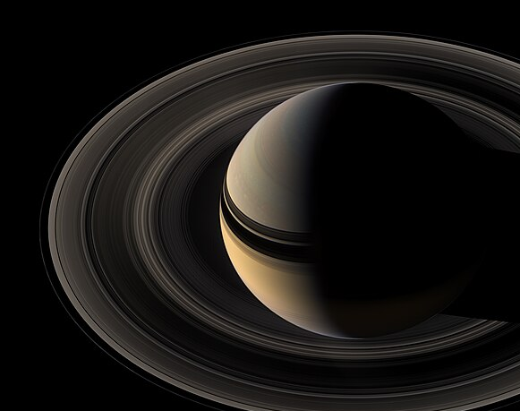
High Contrast Imaging: Past, Present, Future
Logan Pearce
ELT Postdoctoral Fellow
University of Michigan

Slide 2
Outline
Introduction to HCI: Why do it? Why is it hard?
How we do it?
Some current cutting-edge and exciting astrophysics results with HCI
The promising future of HCI

Slide 3
What is High Contrast Imaging (HCI)

Slide 4
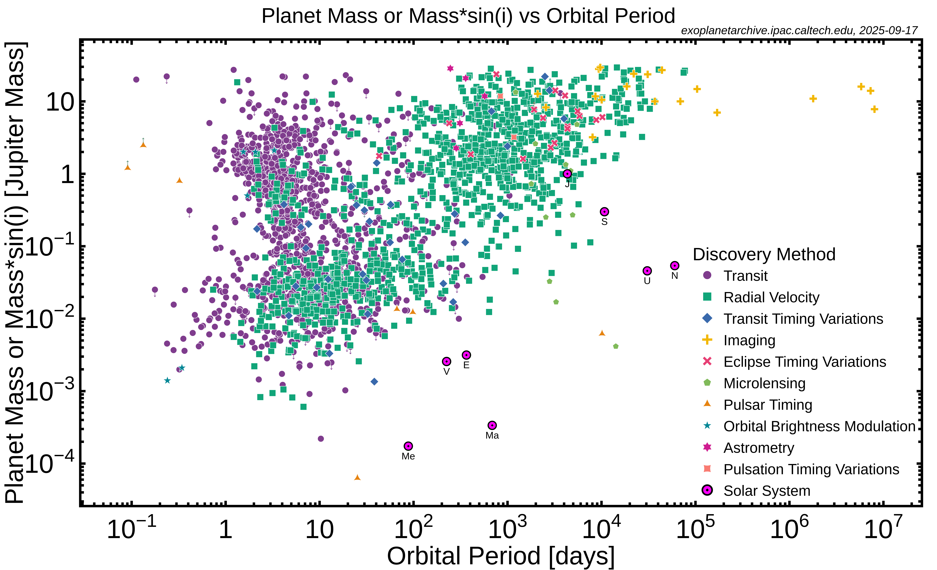
Most exoplanets have been discovered indirectly

Slide 5
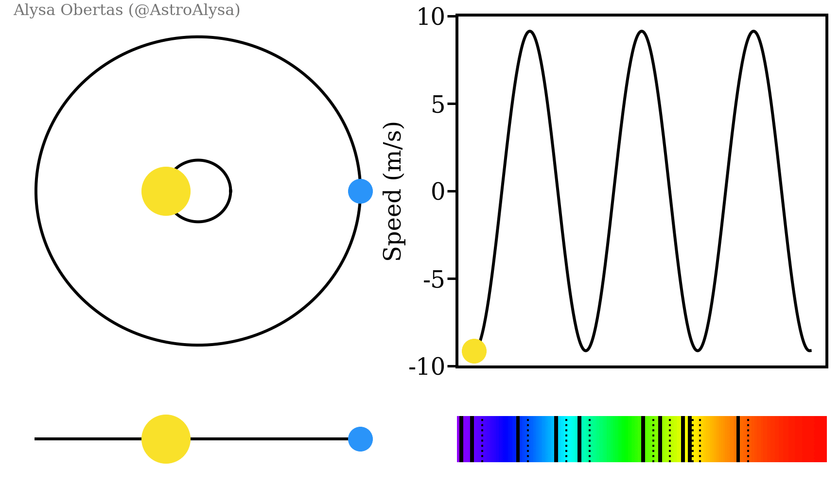
Most exoplanets have been discovered indirectly
Gif credit: Alysa Obertas

Slide 6
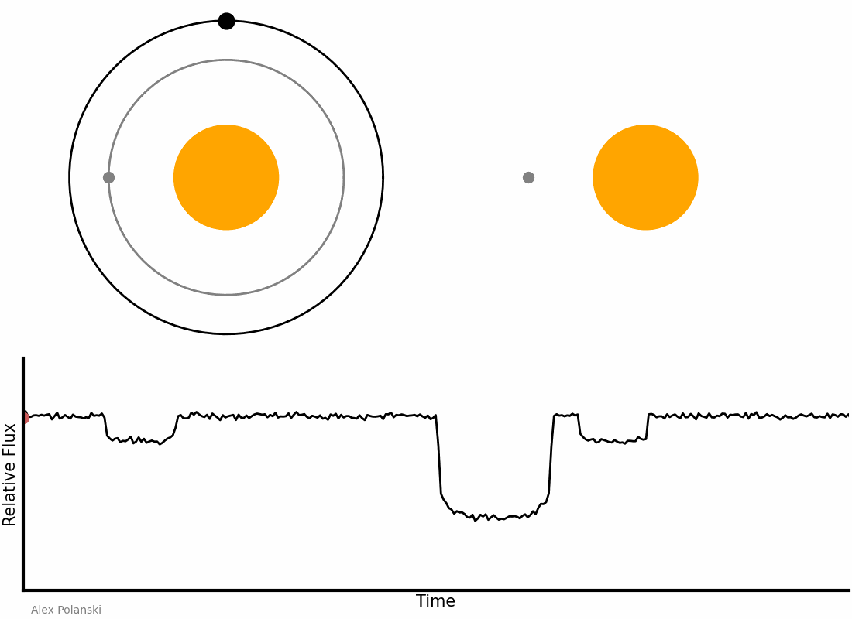
Most exoplanets have been discovered indirectly
Gif credit: Aspolanski/Wikipedia
Gif credit: Alysa Obertas

Slide 7
Most exoplanets have been discovered indirectly
Gif credit: Aspolanski/Wikipedia
Gif credit: Alysa Obertas

Slide 8
Most exoplanets have been discovered indirectly
Gif credit: Aspolanski/Wikipedia
Direct imaging = directly collecting photons from the planet
Gif credit: Alysa Obertas

Slide 9
High Contrast Imaging
“HCI is a catchall term that encompasses the instrumental hardware, image processing techniques, and observing strategies that are employed to enable astronomers to image very faint sources in the vicinity of bright stars.”
Follette 2023

Slide 10
High Contrast Imaging
“HCI is a catchall term that encompasses the instrumental hardware, image processing techniques, and observing strategies that are employed to enable astronomers to image very faint sources in the vicinity of bright stars.”
Follette 2023
Science of looking at a very faint thing very close to a very bright thing

Slide 11
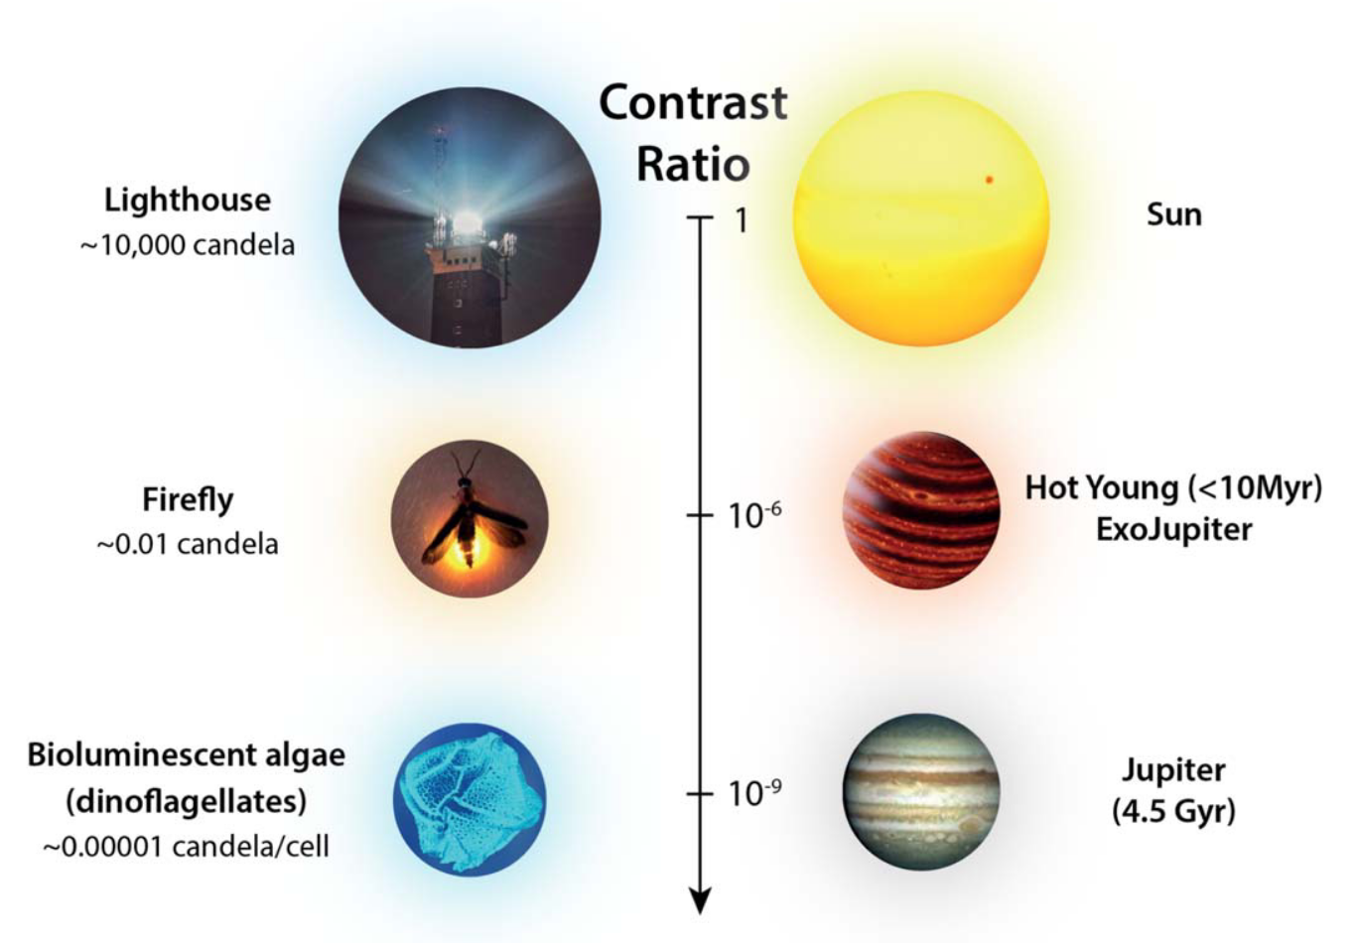
Contrast: planet/star flux ratio
Follette 2023

Slide 12
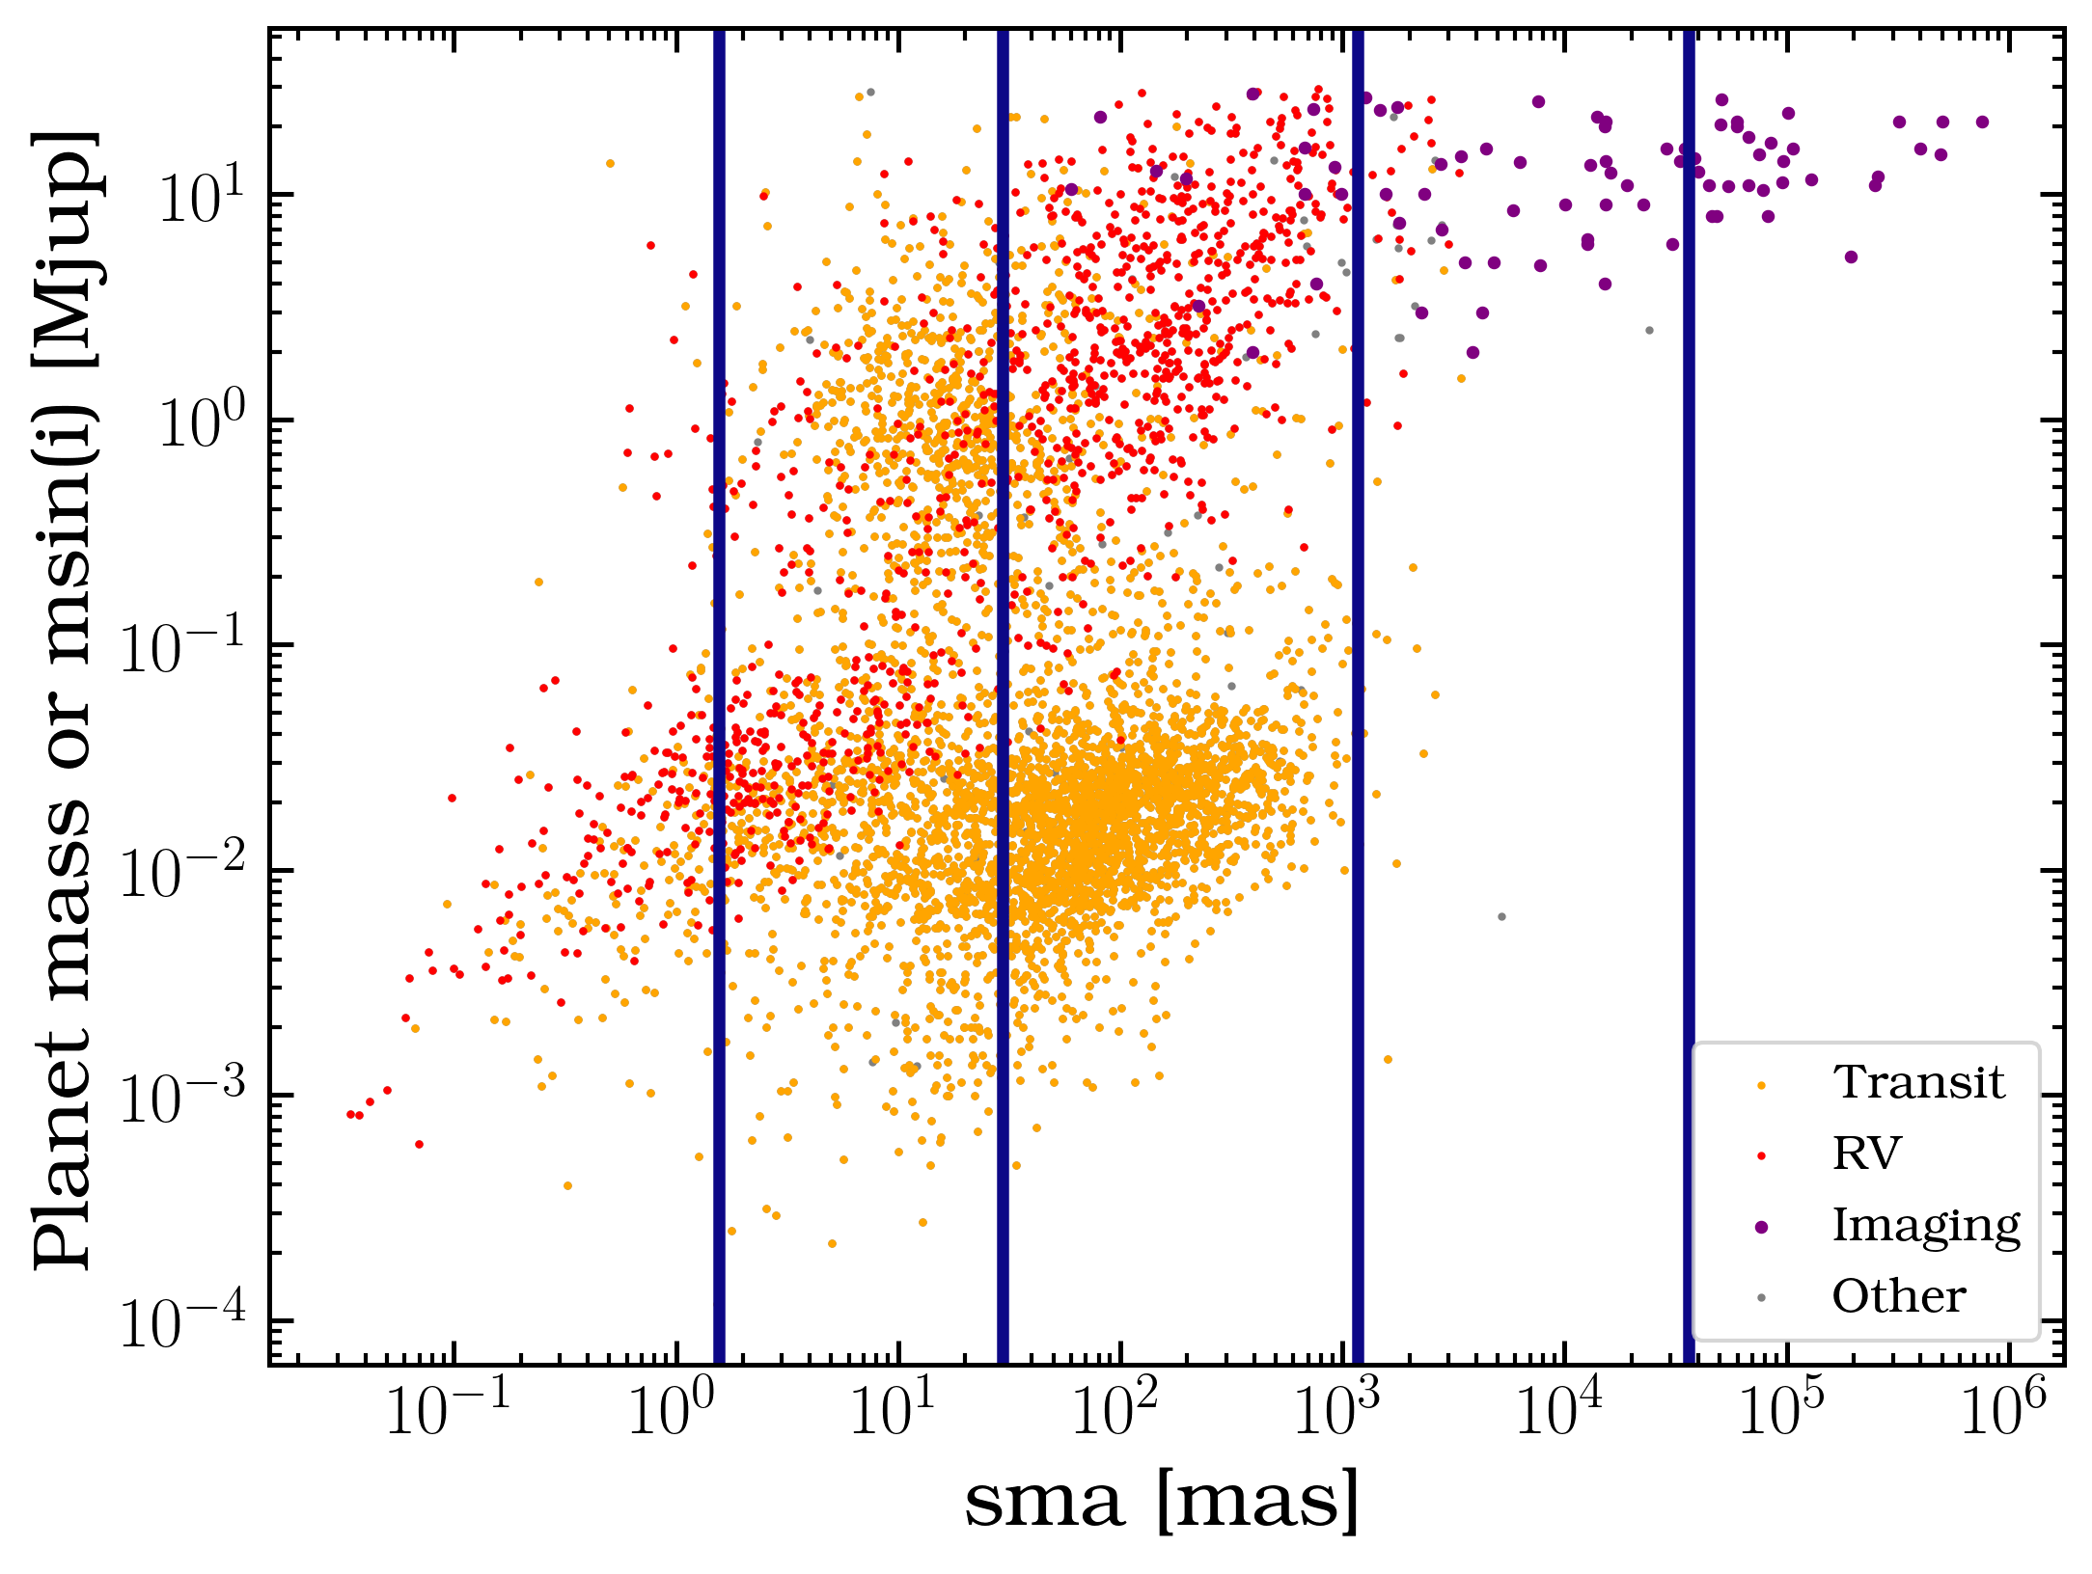
Very faint planets are very close to very bright stars
On the moon…

Slide 13
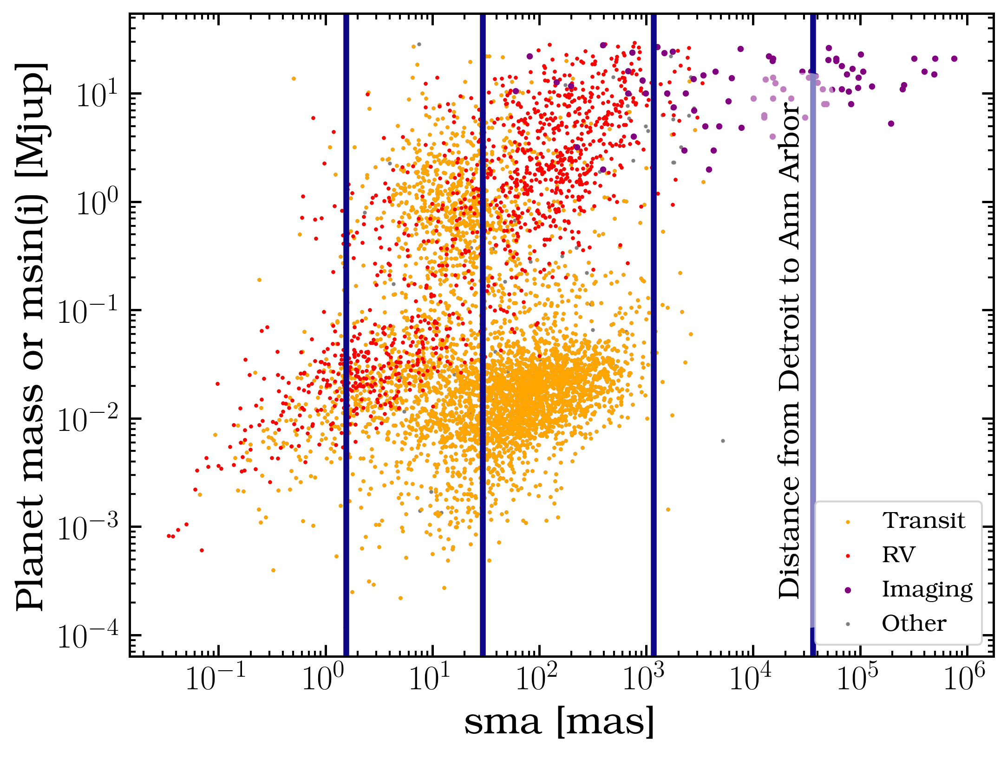
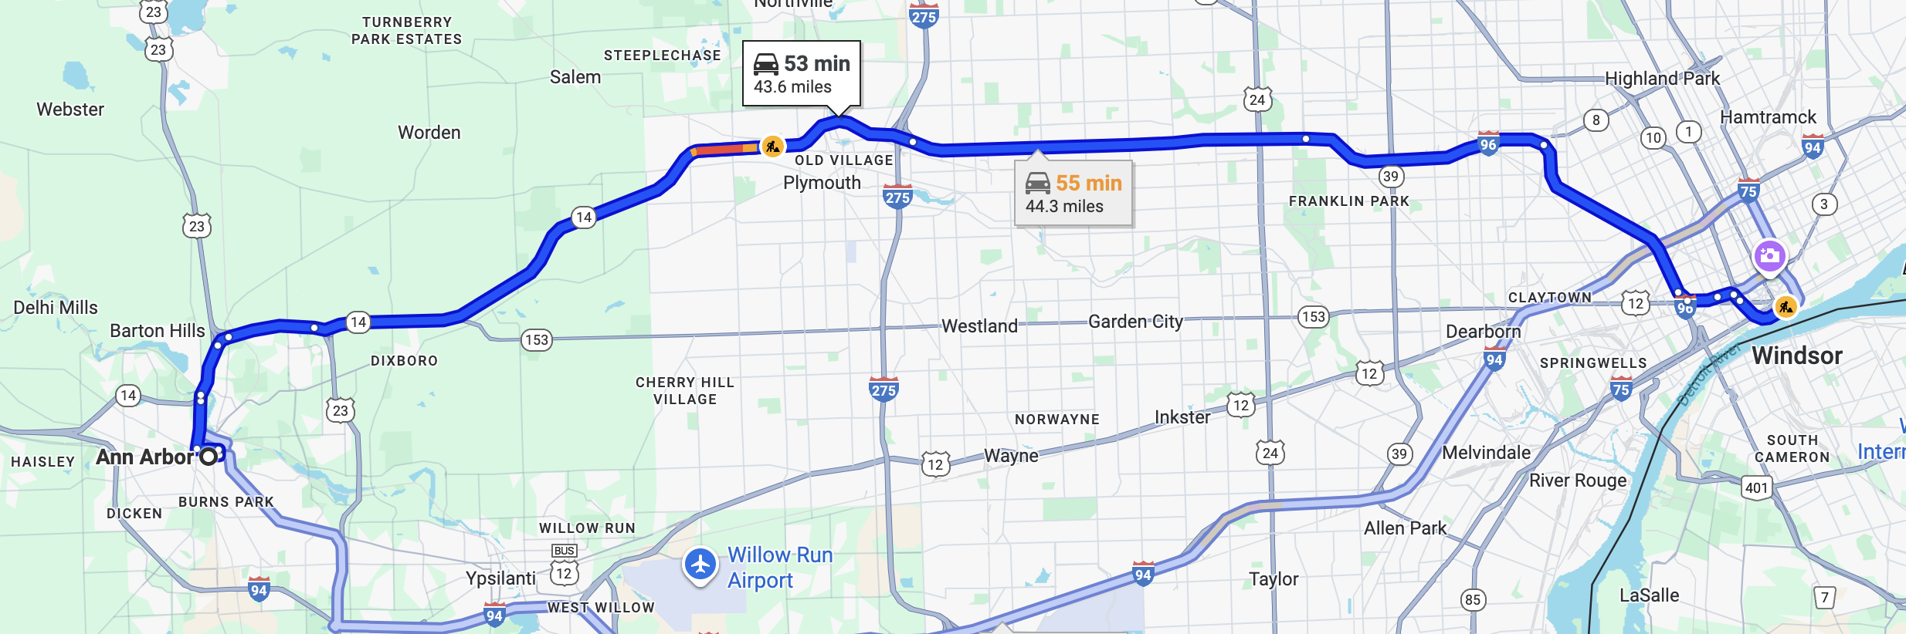
Very faint planets are very close to very bright stars
On the moon…

Slide 14
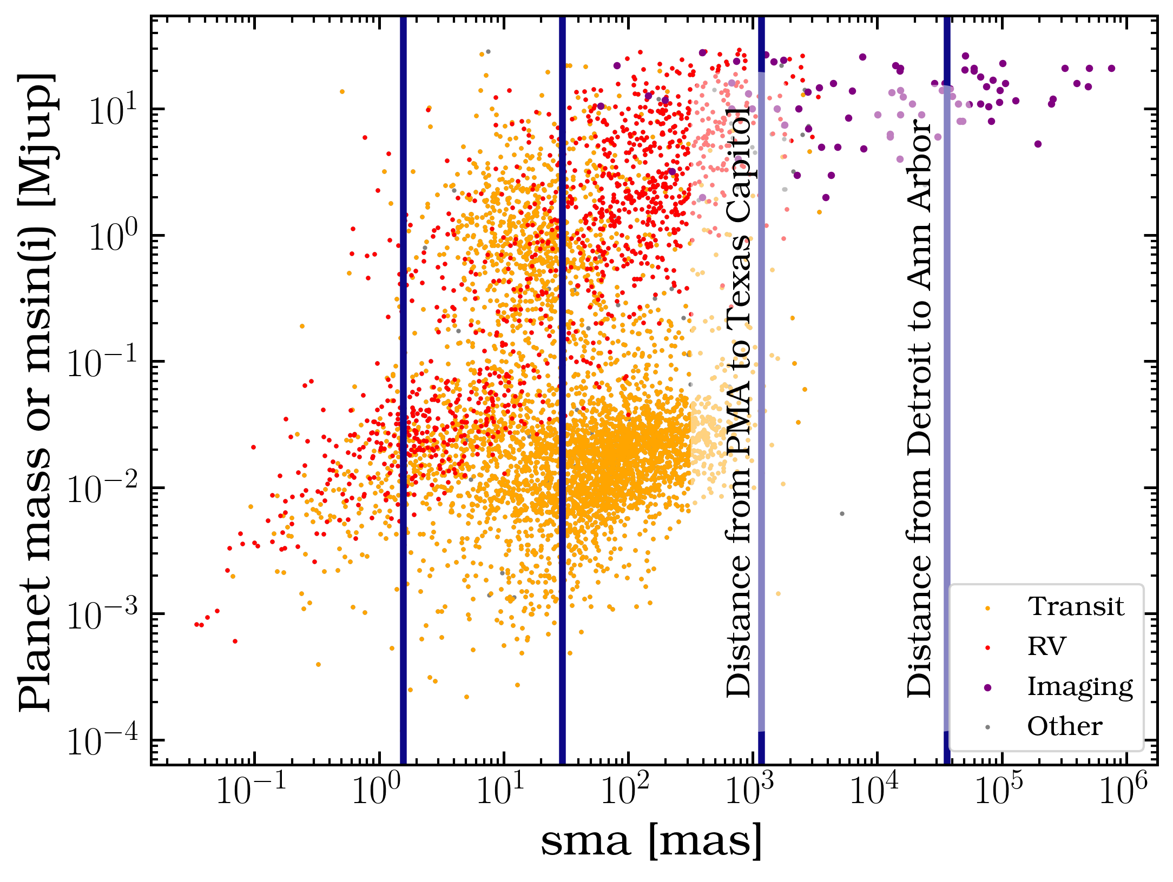
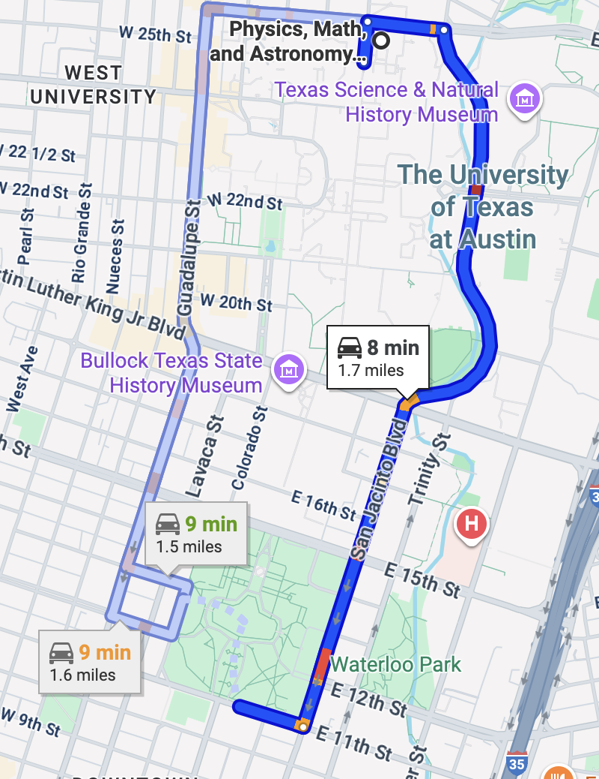
Very faint planets are very close to very bright stars
On the moon…

Slide 15
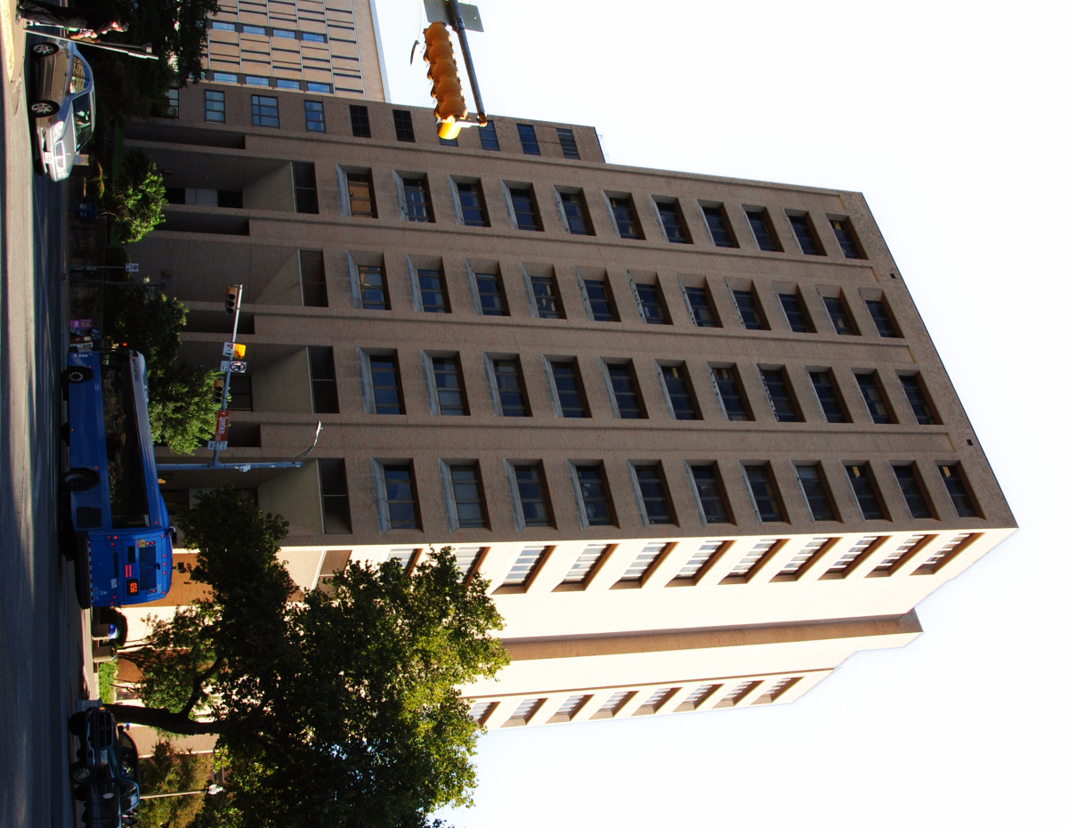
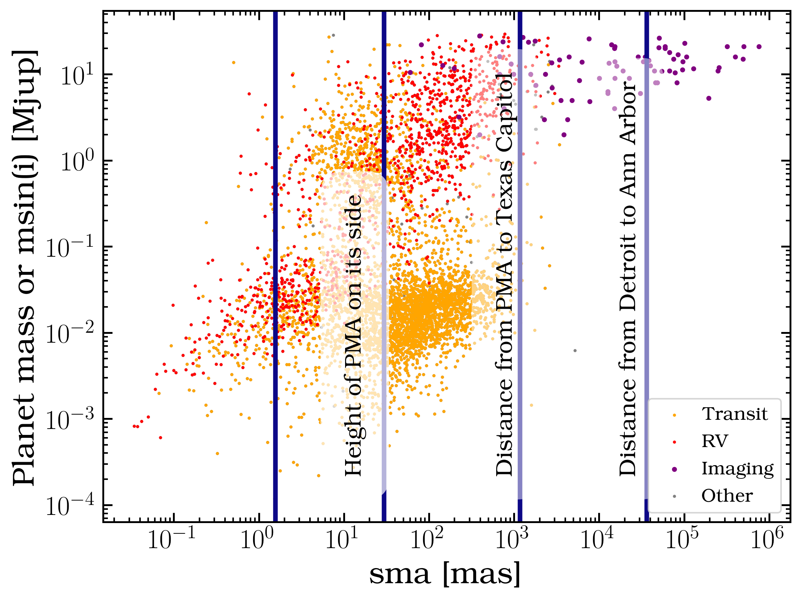
Very faint planets are very close to very bright stars
On the moon…

Slide 16

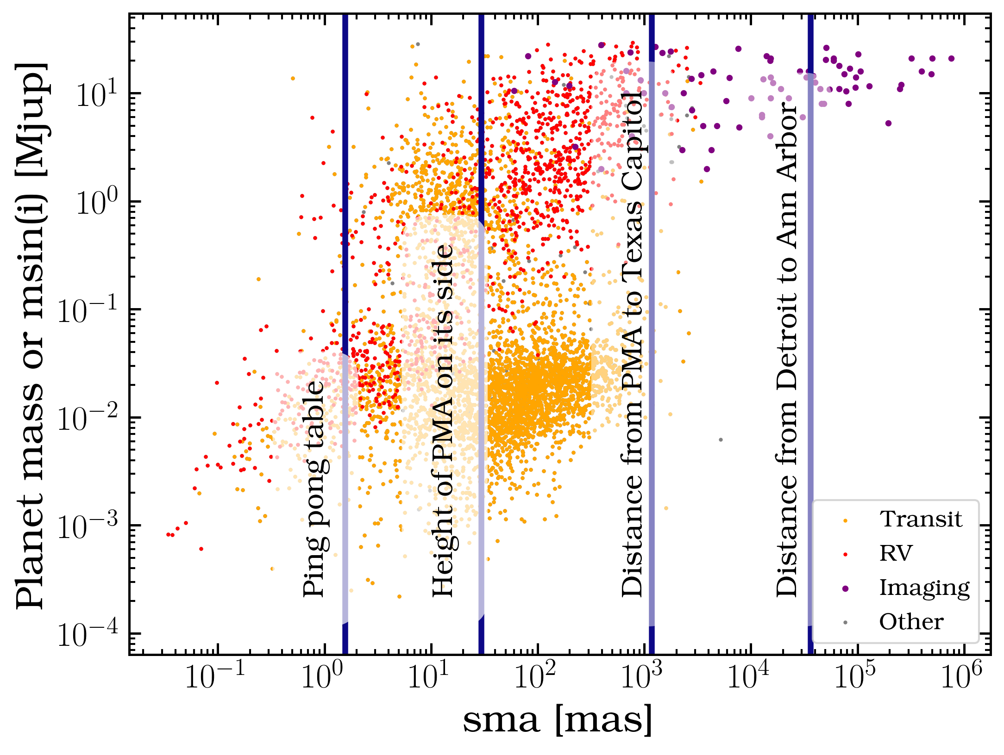
Very faint planets are very close to very bright stars
On the moon…

Slide 17
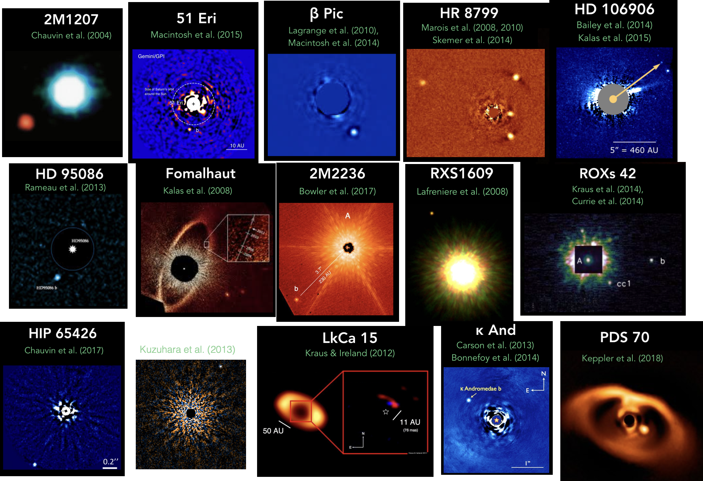
The exoplanet direct detections we have are the result of enormous effort by a large community over a long time

Slide 18
How we directly detect exoplanets

Slide 19

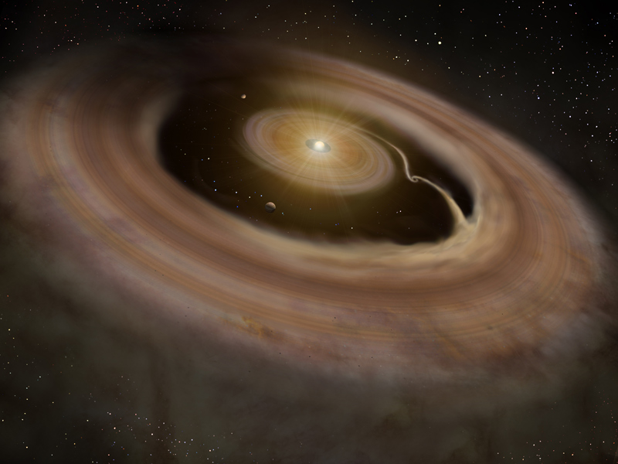


How we directly detect exoplanets: Thermal Emission
Gas and dust
Heats up
Glowing planet
Artist impression/NAOJ

Slide 20
How we directly detect exoplanets: Atomic Emission
Gas and dust
Heats up
H alpha emission lines are signposts of young accreting protoplanets in the process of forming
Excites gas
Excited gas emits in atomic lines
Planet bright in hydrogen lines

Slide 21

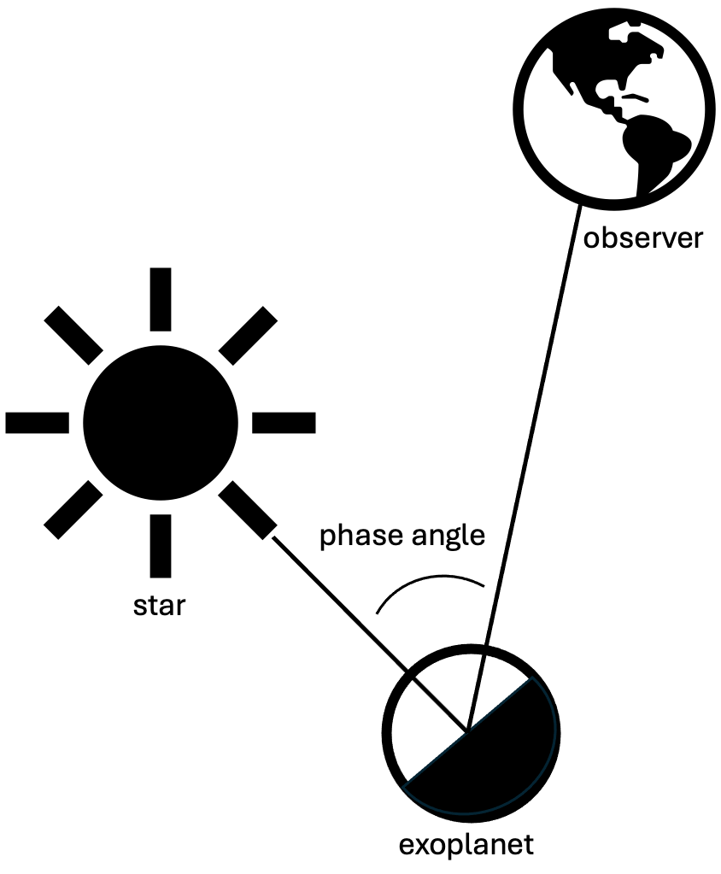

How we directly detect exoplanets: Reflected Light

Slide 22
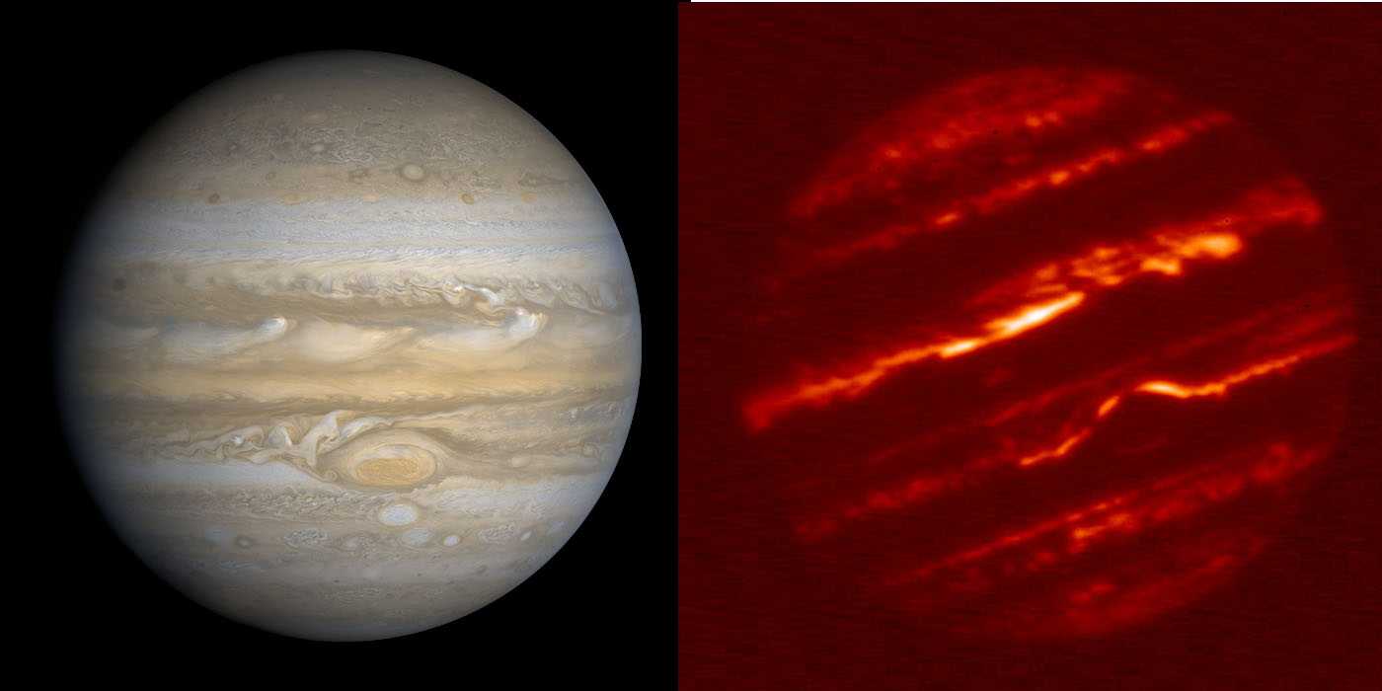
Jupiter in reflected light
Jupiter in thermal emission at 5 um
Image credit: GPI

Slide 23
Direct imaging has historically been sensitive to hot, young, wide, giant planet/brown dwarf companion population
Younger
Brighter
Stars
Brown Dwarfs
Planets
Fainter
Older
Franson & Bowler 2023

Slide 24
Direct imaging has historically been sensitive to hot, young, wide, giant planet/brown dwarf companion population

Slide 25



How we achieve high contrasts

Slide 26
High contrast, high resolution is achieved through some combination of adaptive optics, coronagraphy, image/spectrum post processing
Used on the ground
Not every observation is best served by a coronagraph
HCI instruments can be imagers or spectrographs

Slide 27
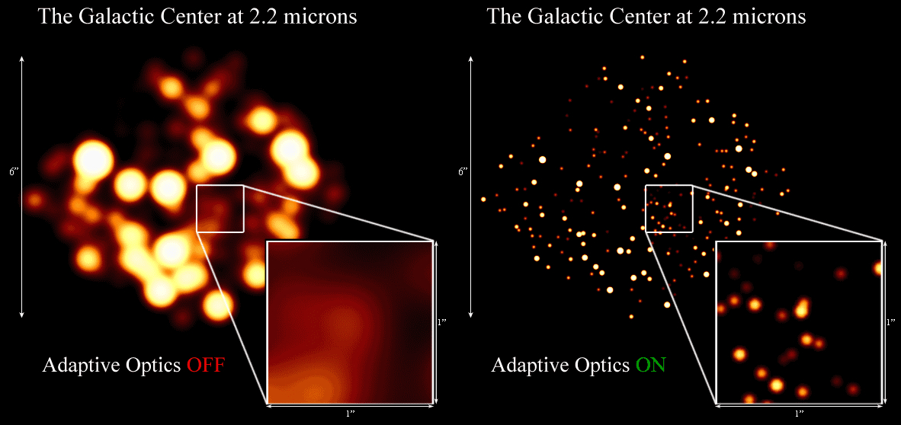
Twinkling is bad for science
Resolution limited by atmospheric seeing
UCLA Galactic Center Group

Slide 28
Twinkling is bad for science
Resolution limited by atmospheric seeing
UCLA Galactic Center Group

Slide 29
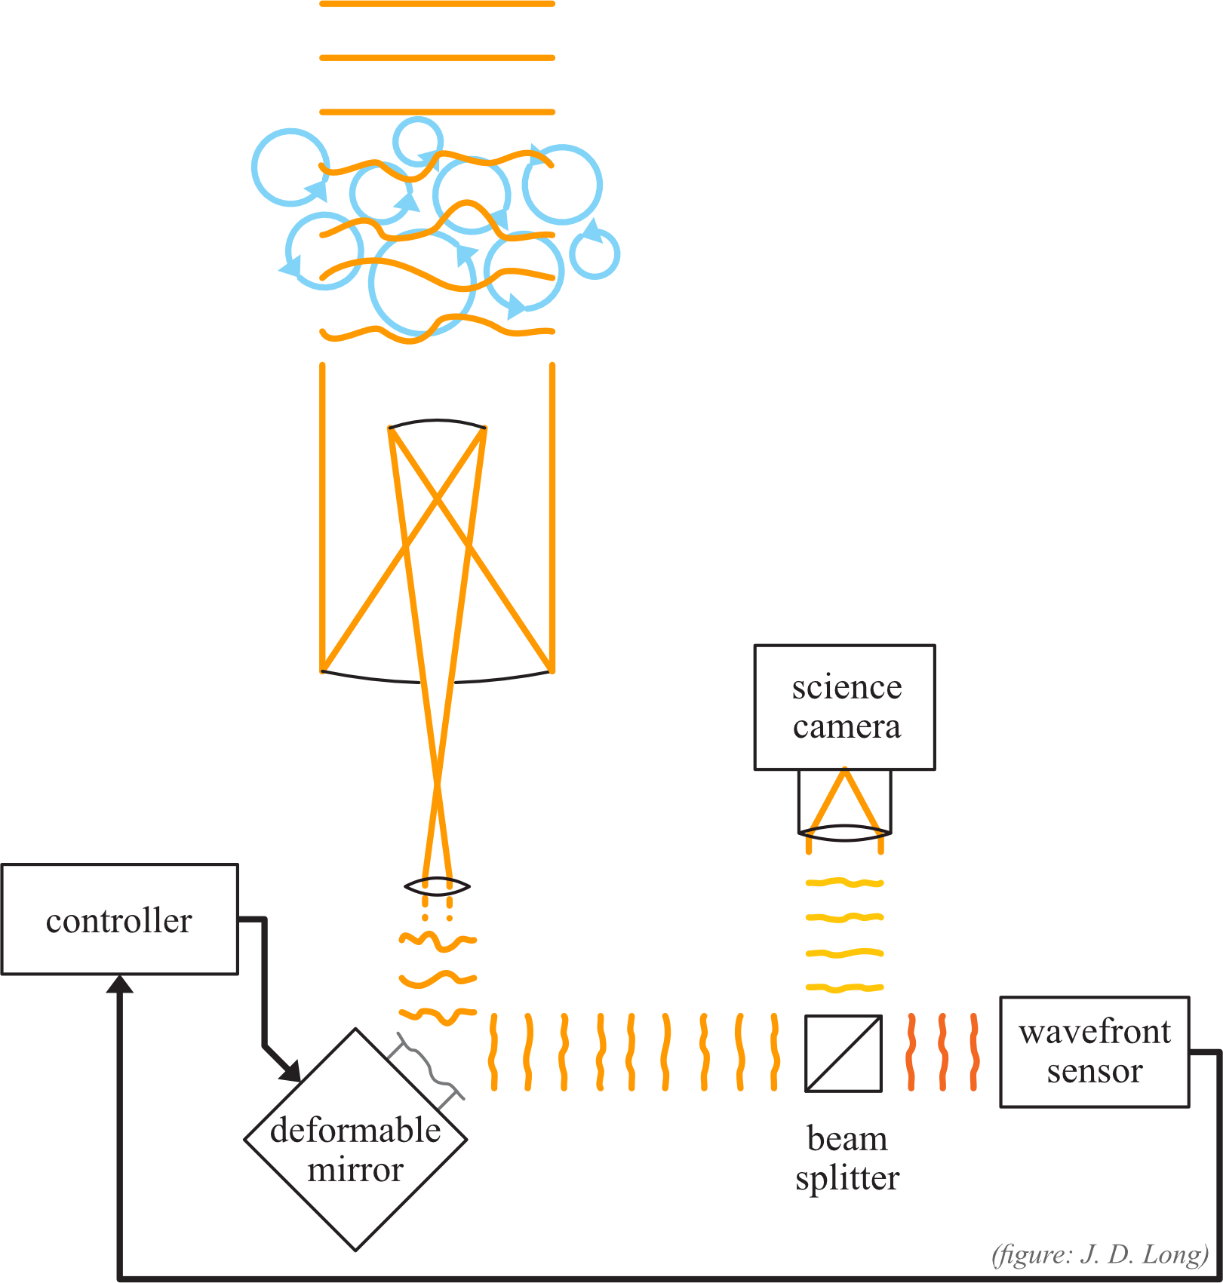
Adaptive Optics: achieving diffraction limited images from the ground
Point spread function (PSF) is characterized by telescope and the wave nature of light
Image credit: Joseph Long

Slide 30
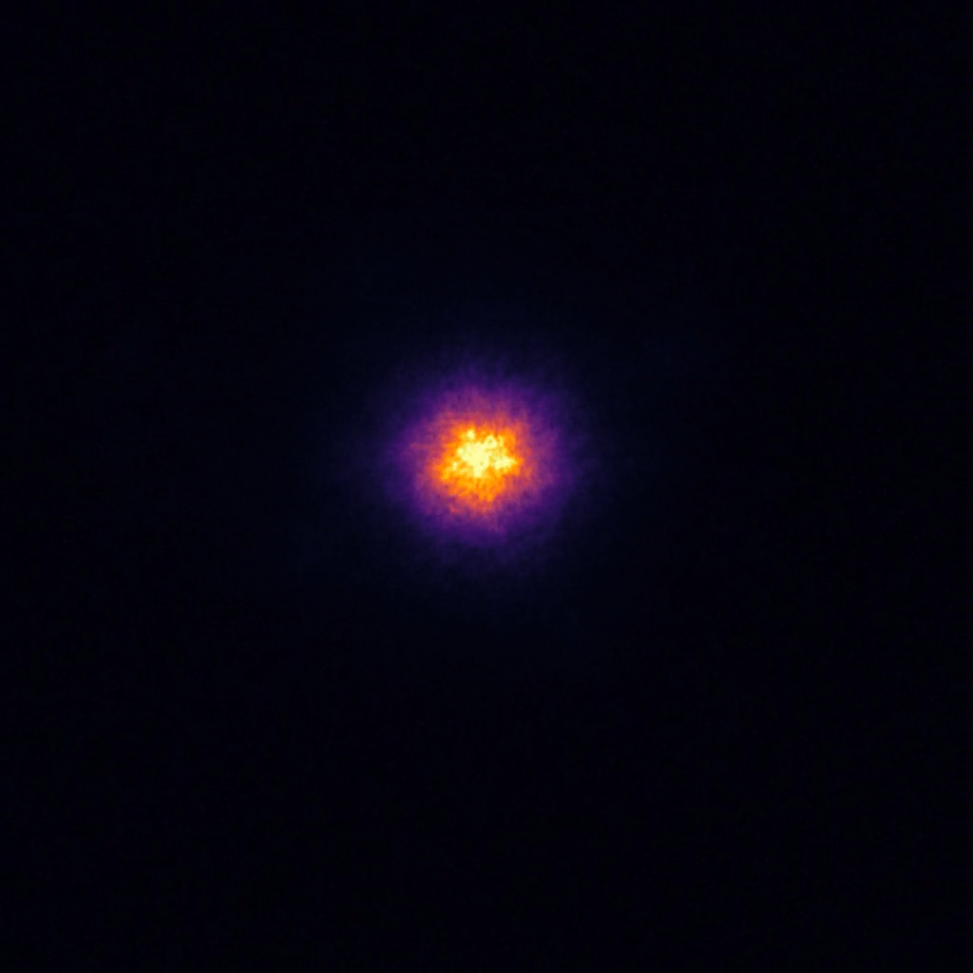

Slide 31
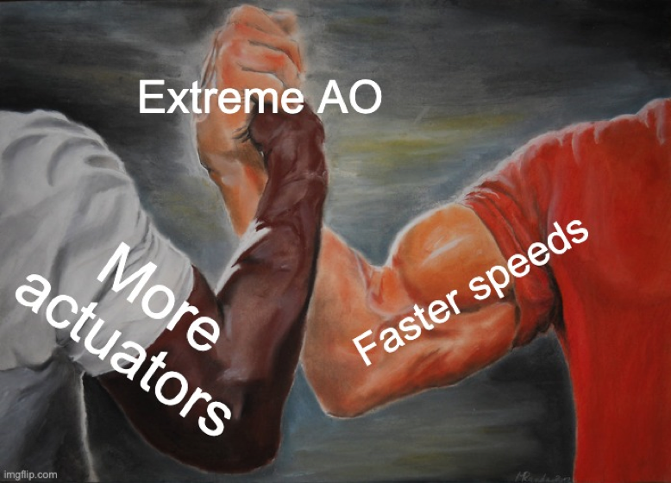
Extreme AO: more actuators, faster speeds

Slide 32
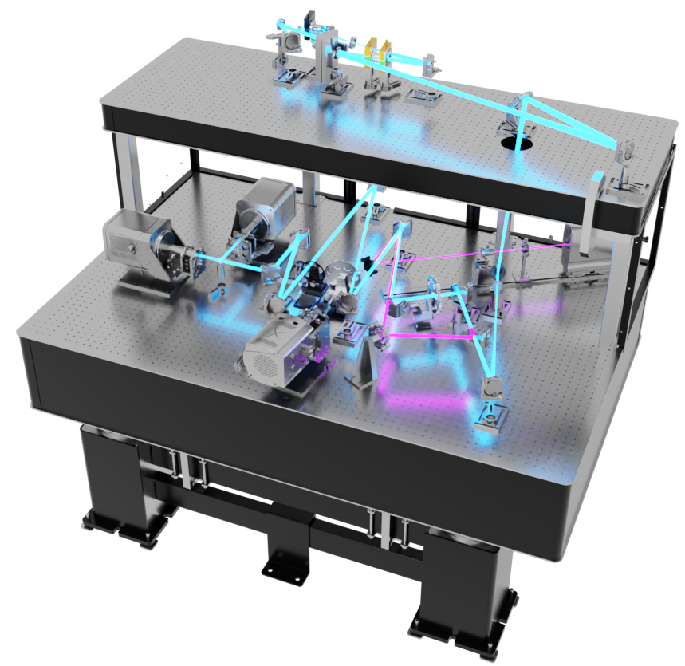

97 actuator “woofer” DM
2K actuator “tweeter” DM
Science Cameras
g’, r’, i’, z’, Ha, CH4
Other ExAO instruments:
VIS-X IFU
SCExAO (Subaru)
VLT+Gravity
Coronagraph and 1K NCPC DM
More at xwcl.science
Credit: Joseph Long

Slide 33
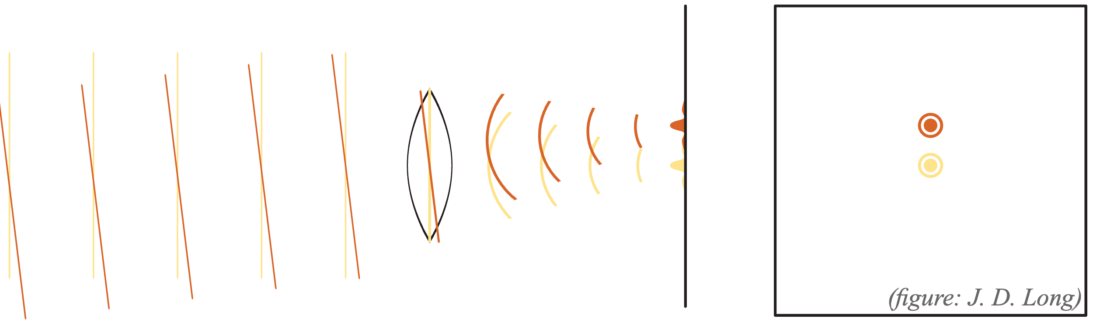
Coronagraphy: block bright stuff to see faint stuff
Image credit: Joseph Long

Slide 34
Coronagraphy: block bright stuff to see faint stuff
Image credit: Joseph Long

Slide 35
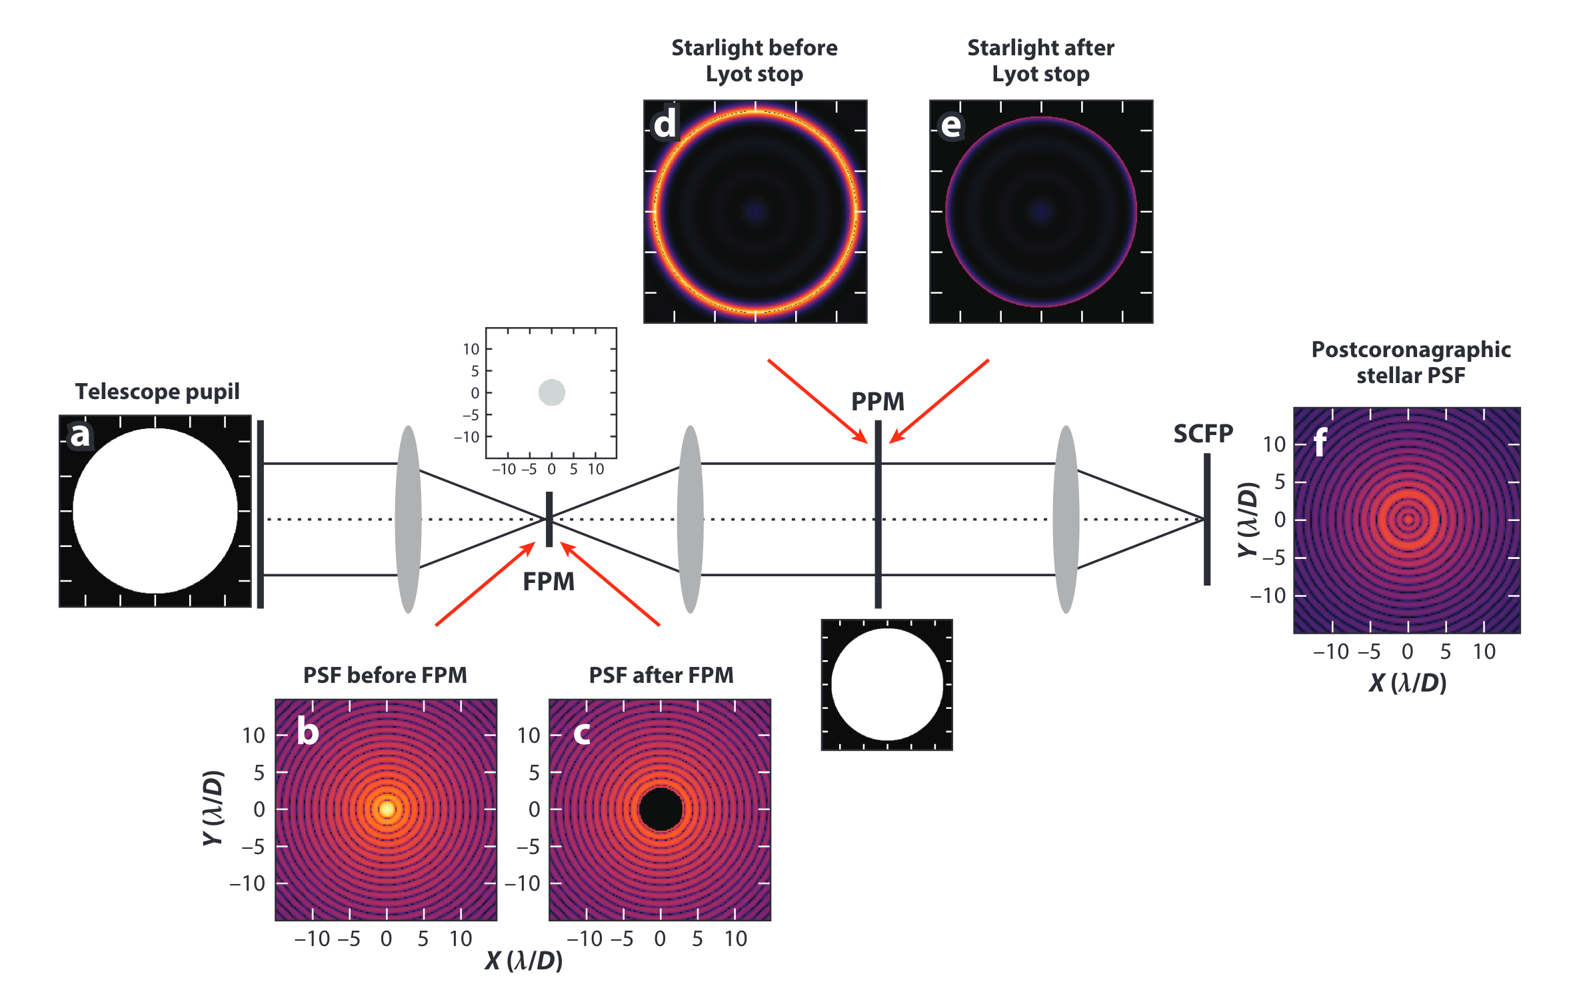
Kenworthy & Haffert 2025

Slide 36
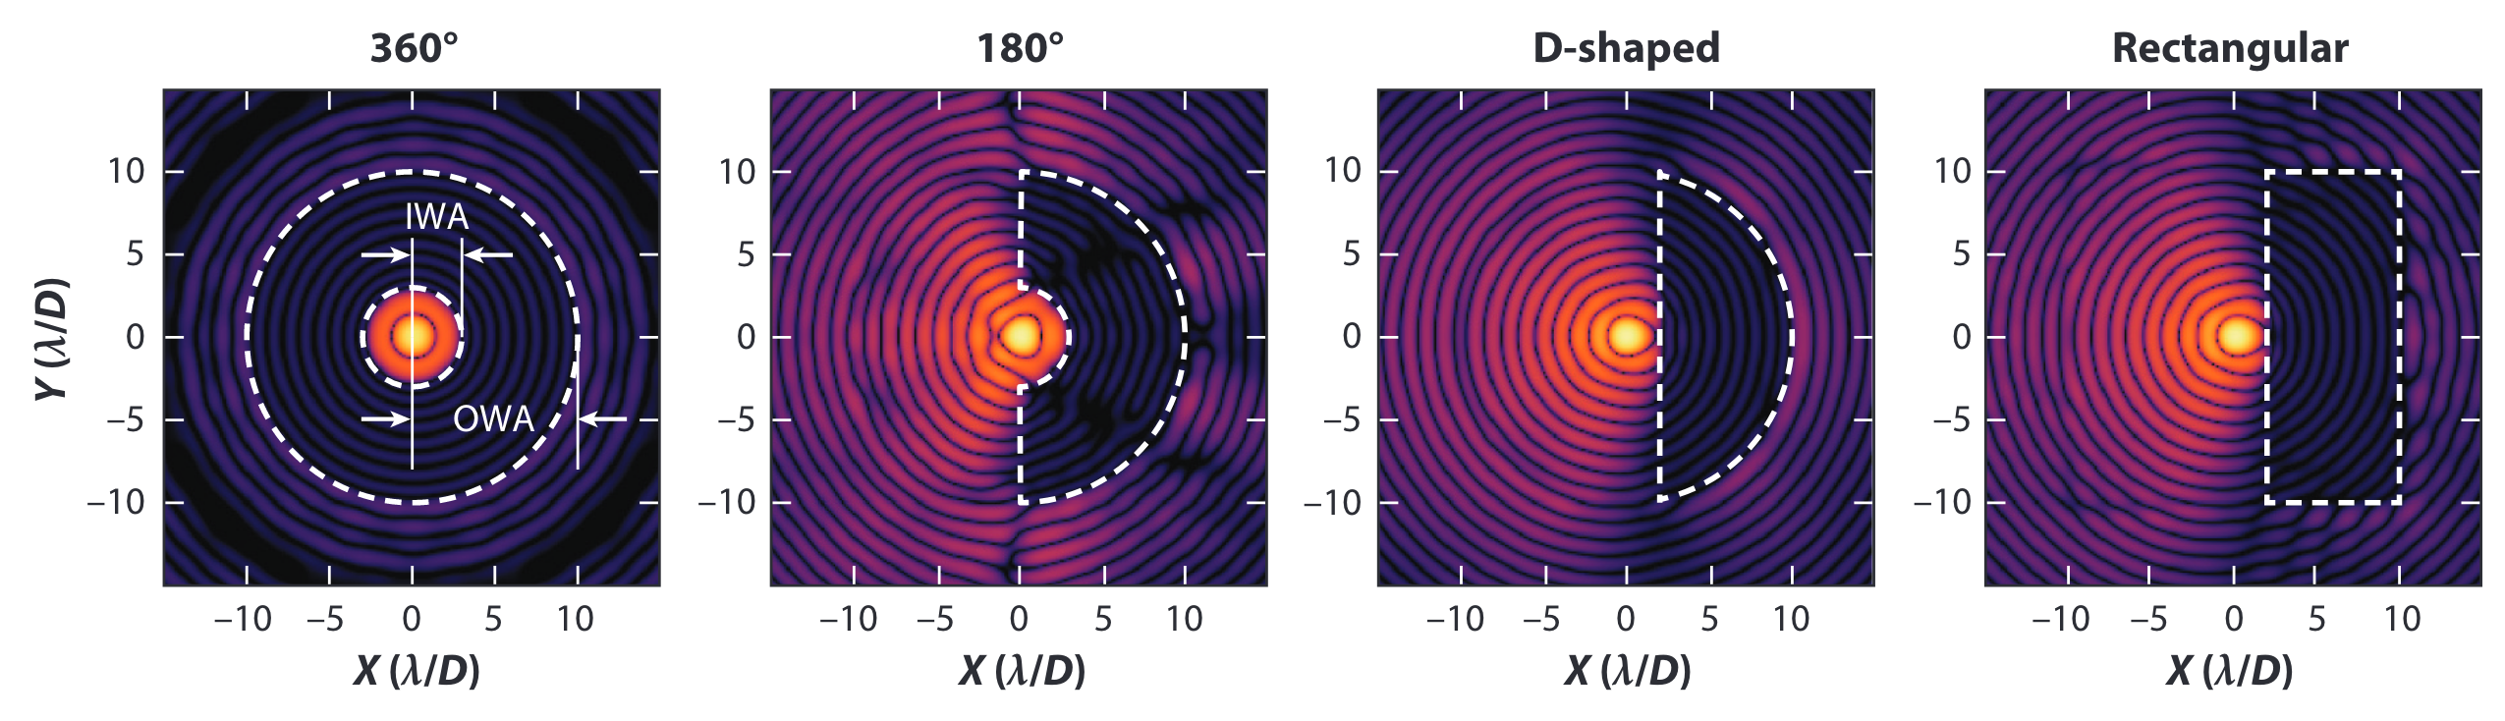
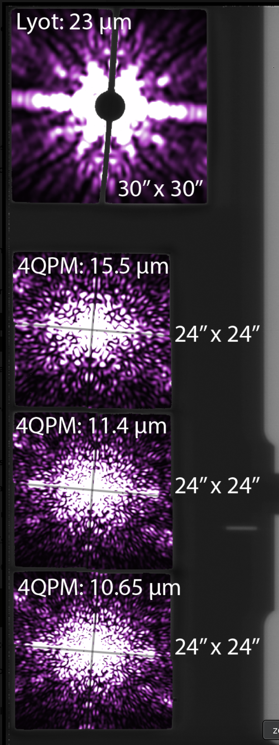
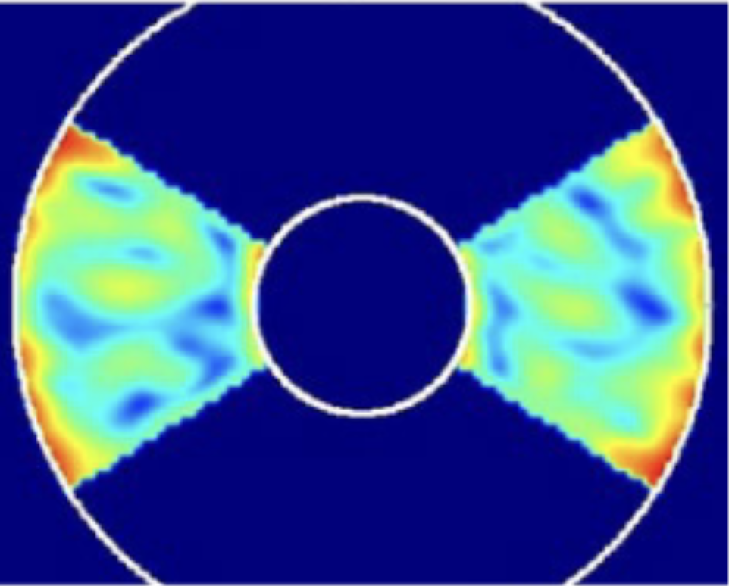
Advanced coronagraph designs dig “dark holes”
JWST MIRI 4QPM
Kenworthy & Haffert 2025
Roman Shaped Pupil “bowtie” dark hole
Boccaletti et al. 2022
Roman CGI Ref Information Document

Slide 37
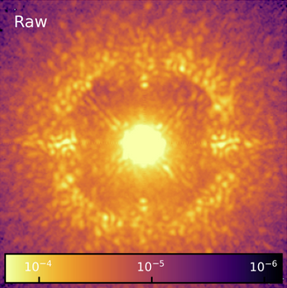
Post processing: remove stellar halo and speckles
Galicher & Mazoyer 2023
Speckles: Copies of the stellar PSF due to imperfect optics and correction that look just like a point source!

Slide 38
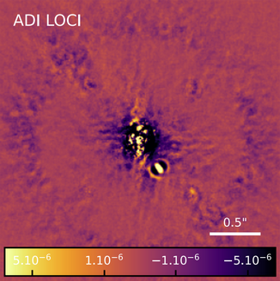
Post processing: remove stellar halo and speckles
Galicher & Mazoyer 2023

Slide 39
Post processing: remove stellar halo and speckles
Galicher & Mazoyer 2023
We need a way to reconstruct the stellar PSF without any companion signal to perfectly subtract optical signals from astrophysical ones

Slide 40
Reference Differential Imaging: Image other reference stars
Images of reference star
Construct model of PSF
Subtract model from science images
Images of science star
Combine

Slide 41
Angular Differential Imaging: Exploit the fact that the sky rotates
Derotate and Combine

Slide 42
Spectral Differential Imaging: Exploit the fact that some sources emit strongly at specific wavelengths
Narrowband images centered on emission line
Narrowband continuum images centered just off emission line
Gas and dust
Heats up
Excites gas
Planet bright in hydrogen lines

Slide 43

Astrophysics with HCI

Slide 44
Direct imaging is tackling some key science questions
Properties of nearby planetary systems and how these properties inform formation and dynamical history
Chemical composition of temperate Neptunes and Giant Planets and implication for atmospheric processes
Protoplanet interactions with gas, dust, circumplanetary disk
Planet forming disk characteristics, snowlines impact on planet formation
Debris disk characteristics and interaction with planets
Exomoons and exorings and connection to dynamical processes
Habitability of rocky planets and biosignatures

Slide 45
Direct imaging is tackling some key science questions
Properties of nearby planetary systems and how these properties inform formation and dynamical history
Chemical composition of temperate Neptunes and Giant Planets and implication for atmospheric processes
Protoplanet interactions with gas, dust, circumplanetary disk
Planet forming disk characteristics, snowlines impact on planet formation
Debris disk characteristics and interaction with planets
Exomoons and exorings and connection to dynamical processes
Habitability of rocky planets and biosignatures

Slide 46
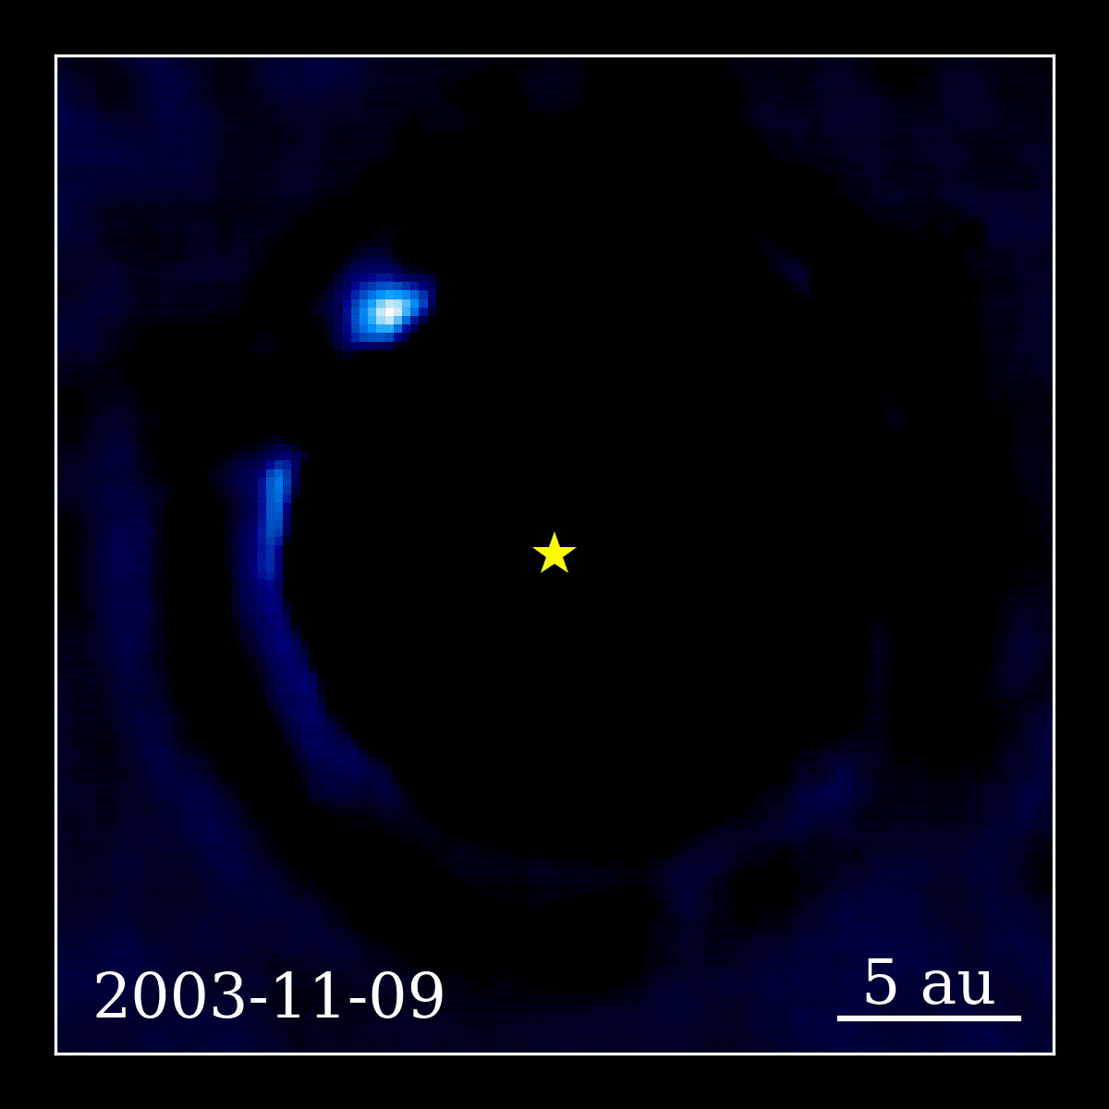
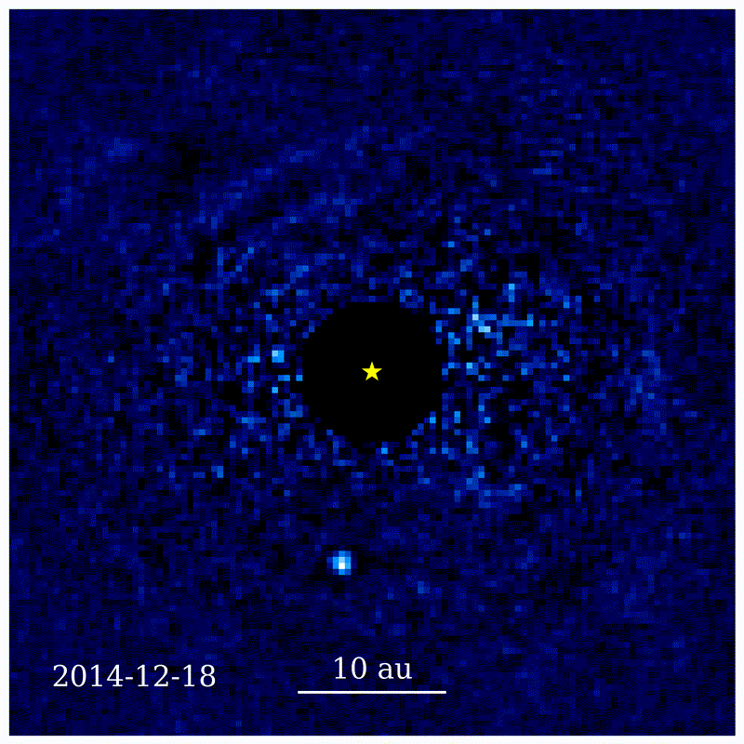
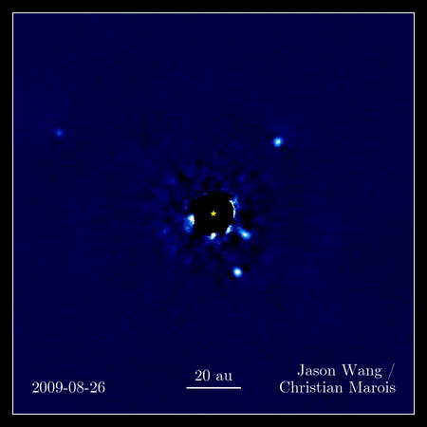
Direct imaging is tackling some key science questions
Properties of nearby planetary systems and how these properties inform formation and dynamical history
Chemical composition of temperate Neptunes and Giant Planets and implication for atmospheric processes
Protoplanet interactions with gas, dust, circumplanetary disk
Planet forming disk characteristics, snowlines impact on planet formation
Debris disk characteristics and interaction with planets
Exomoons and exorings and connection to dynamical processes
Habitability of rocky planets and biosignatures
Beta Pic b
51 Eri b
HR 8799

Slide 47
Direct imaging has historically been sensitive to hot, young, wide, giant planet/brown dwarf companion population
Younger
Brighter
Stars
Brown Dwarfs
Planets
Fainter
Older
Franson & Bowler 2023

Slide 48
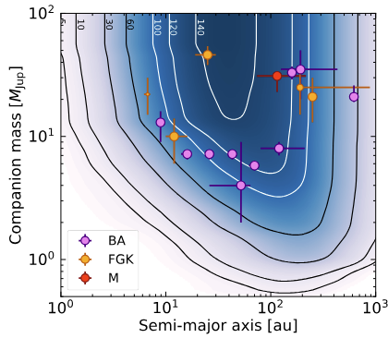
Blind search surveys of young star formation regions and moving groups probed population of wide giant planet and brown dwarf companions
Vigan et al. 2021:
SHINE survey with VLT
Substellar companion occurrence rates:
BA: 23%
FGK: 6%
M: 13%
Nielsen et al. 2019:
GPIES survey with GPI
BD occurrence rate: 3.5%
GP occurrence rate: 0.8%

Slide 49
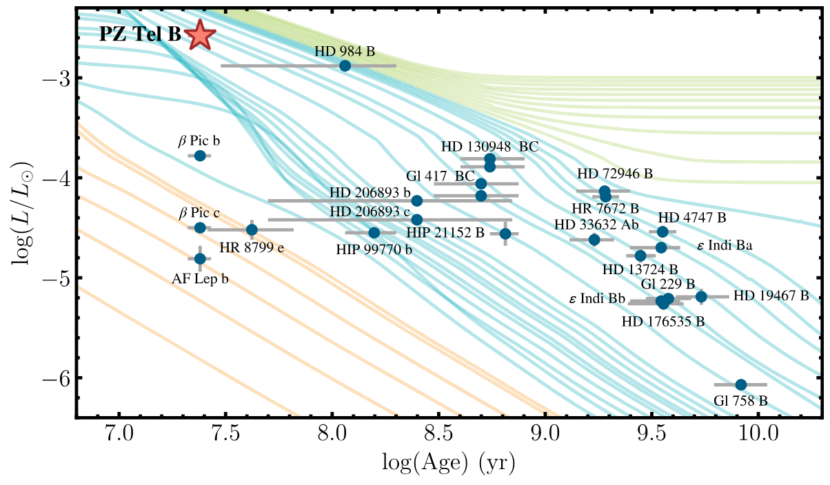
Direct imaging has historically been sensitive to hot, young, wide, giant planet/brown dwarf companion population
Younger
Brighter
Stars
Brown Dwarfs
Planets
Fainter
Older
Franson & Bowler 2023

Slide 50
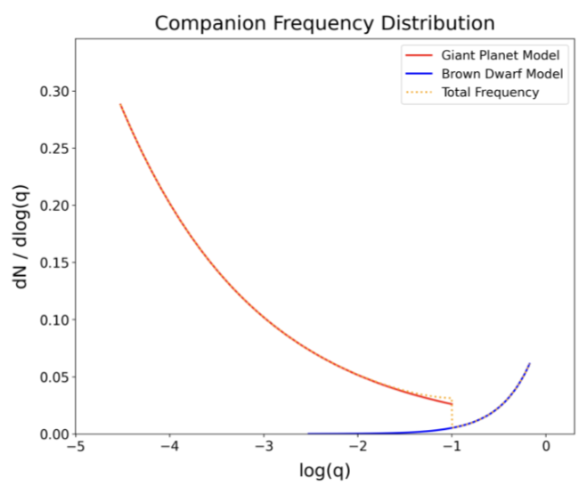
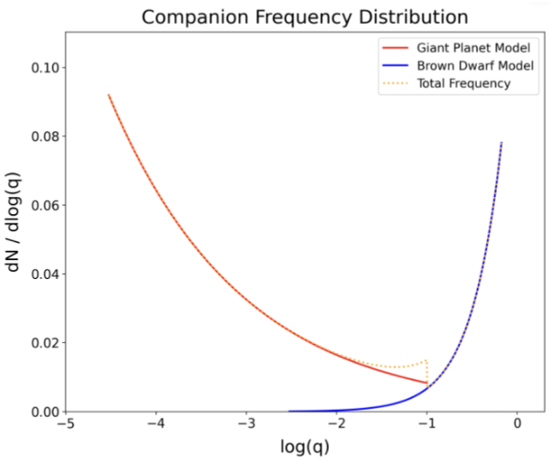
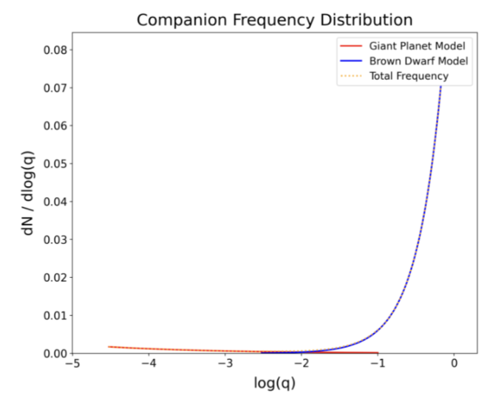
Direct imaging has probed GP/BD populations -> demographics
Meyer, Li et al. 2025
For FGK stars
0.1 – 1 au
1 – 10 au
10 – 100 au
Occurrence rate
Planet/star mass ratio
Planet/star mass ratio
Planet/star mass ratio
The same trend is seen in BA and M type stars

Slide 51
Direct imaging has probed GP/BD populations -> demographics
Lower mass planets are more common
Meyer, Li et al. 2025
For FGK stars
0.1 – 1 au
1 – 10 au
10 – 100 au
Occurrence rate
Planet/star mass ratio
Planet/star mass ratio
Planet/star mass ratio
The same trend is seen in BA and M type stars

Slide 52
Direct imaging has probed GP/BD populations -> demographics
Lower mass planets are more common
Overall occurrence rate decreases with semi-major axis
Meyer, Li et al. 2025
For FGK stars
0.1 – 1 au
1 – 10 au
10 – 100 au
Occurrence rate
Planet/star mass ratio
Planet/star mass ratio
Planet/star mass ratio
The same trend is seen in BA and M type stars

Slide 53
Direct imaging has probed GP/BD populations -> demographics
Lower mass planets are more common
Overall occurrence rate decreases with semi-major axis
Meyer, Li et al. 2025
For FGK stars
0.1 – 1 au
1 – 10 au
10 – 100 au
Different formation pathways for these different populations?
Occurrence rate
Planet/star mass ratio
Planet/star mass ratio
Planet/star mass ratio
The same trend is seen in BA and M type stars

Slide 54

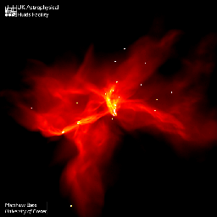
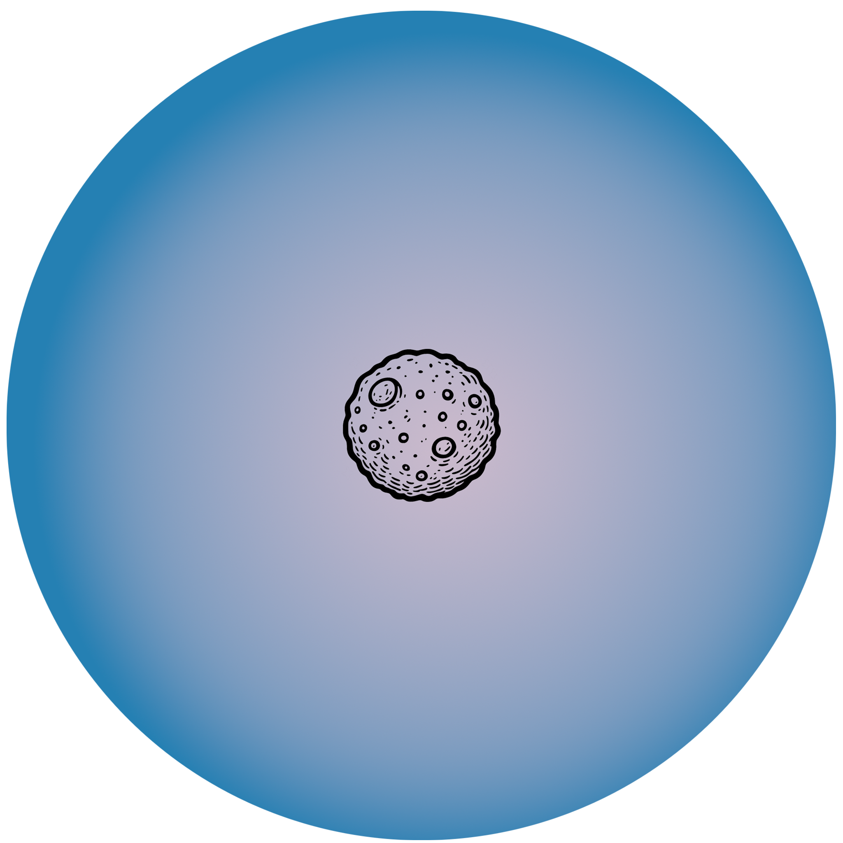
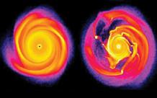
Tests of formation pathways -> top down or bottom up?
Core accretion
Disk Gravitational Instability
Molecular cloud collapse
Core forms
Protoplanetary disk fragments into massive clumps
Collapses into massive planets/BD
Massive substellar object collapse directly from protostellar cloud
Accretes planetesimals
Accretes gas and dust
Runaway gas accretion

Slide 55
Tests of formation pathways -> top down or bottom up?
Core accretion
Disk Gravitational Instability
Molecular cloud collapse
Core forms
Protoplanetary disk fragments into massive clumps
Collapses into massive planets/BD
Massive substellar object collapse directl from protostellar cloud
Accretes planetesimals
“Planet like”
“Brown dwarf like”
“Star like”
Accretes gas and dust
Runaway gas accretion

Slide 56
Tests of formation pathways: metallicity tracers of formation process and birth environment
HR 8799: Four-planet system
All ~10 Mjup
16, 24, 38, 68 au

Slide 57
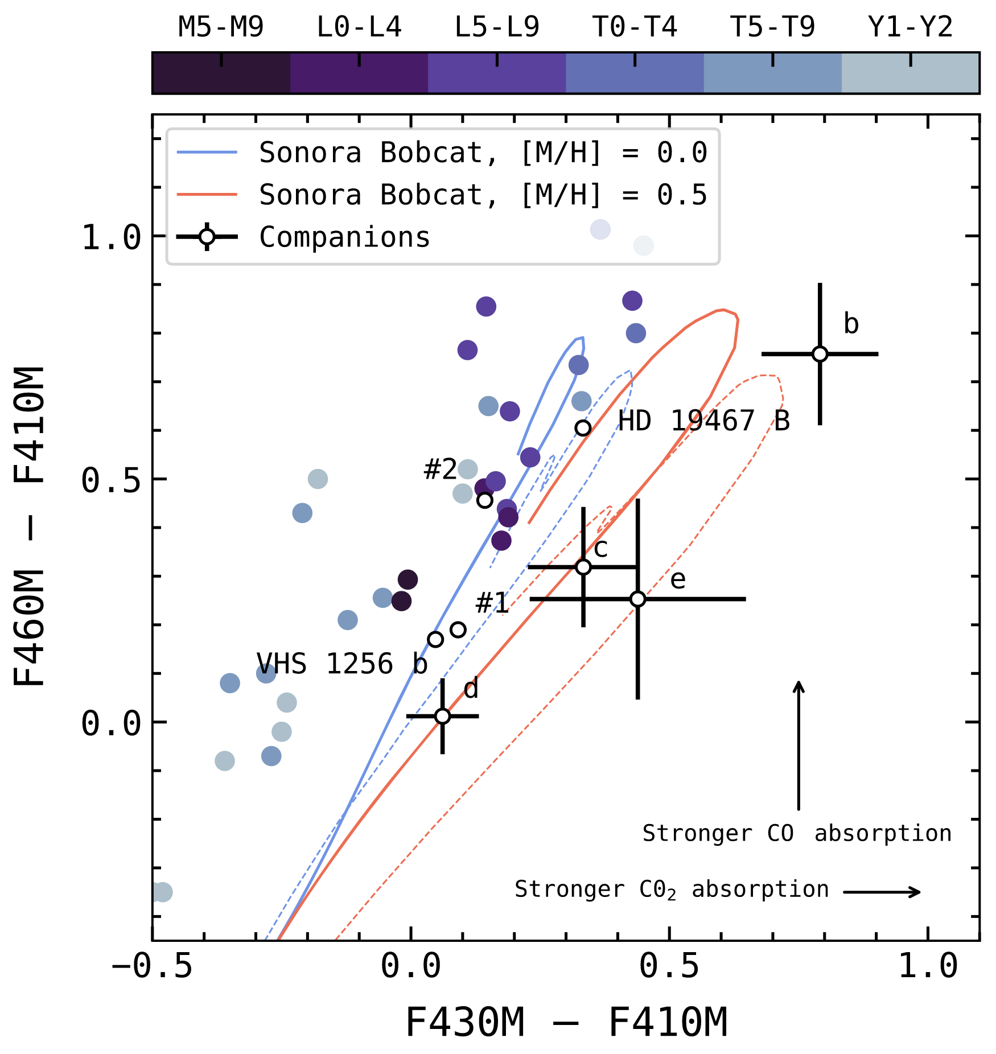
Balmer et al. 2025b
HR 8799 planets show higher metallicity than field brown dwarfs and likely higher than their host star
Solar

Slide 58
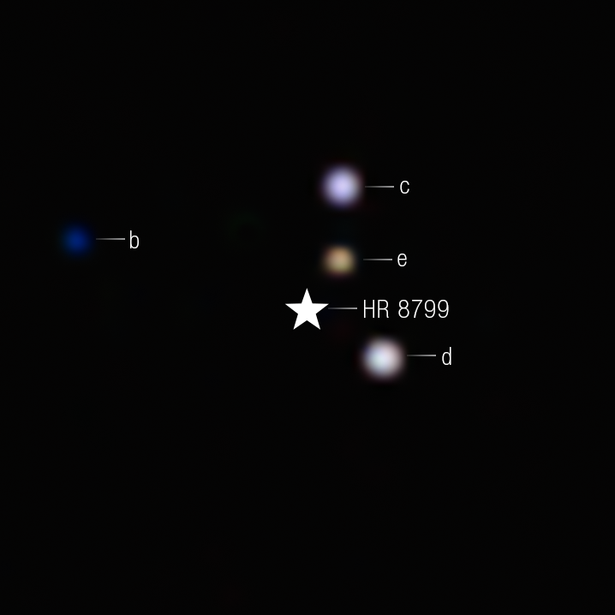
And their metallicities are different from each other as well -> formed in a differentiated disk?

Slide 59
And their metallicities are different from each other as well -> formed in a differentiated disk?
Balmer et al. 2025b:
Core accretion likely explanation, and can form several massive planets on wide separations

Slide 60
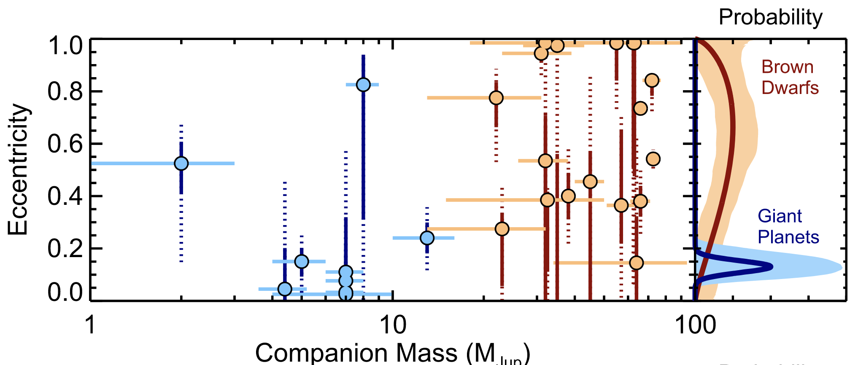
Signposts of dynamical history: Brown dwarf and giant planet companions have different eccentricity distributions
Bowler et al. 2020
Points to formation in a disk for giant planets and cloud collapse for brown dwarfs

Slide 61
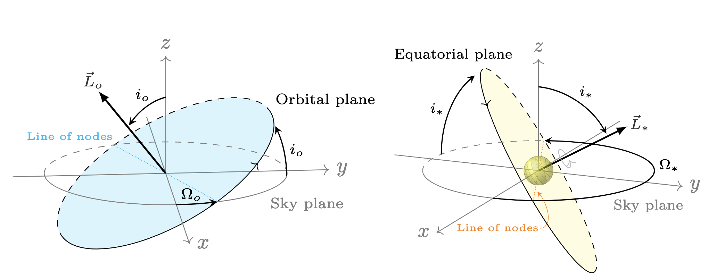
Signposts of dynamical history: Brown dwarf and giant planet companions have different trends in spin-orbit (mis)alignment
Bowler et al. 2023
Alignment between stellar spin axis and companion orbit angular momentum vector

Slide 62
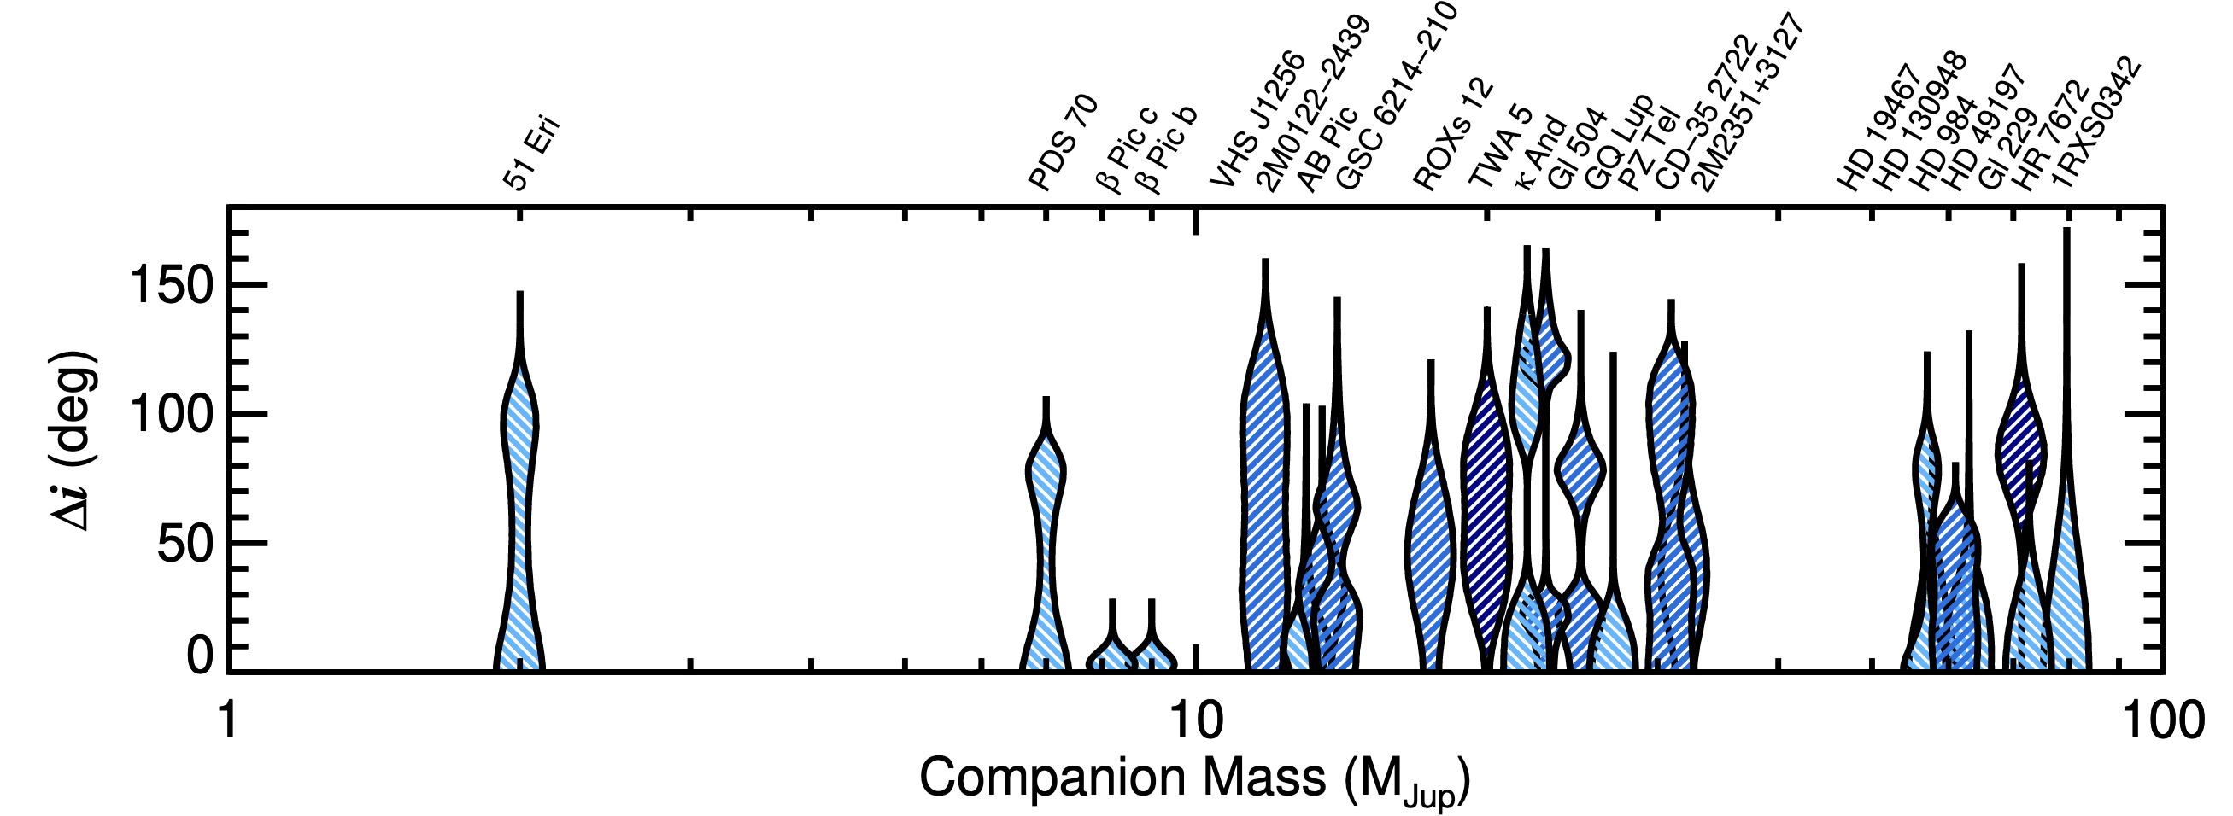
Signposts of dynamical history: Brown dwarf and giant planet companions have different trends in spin-orbit (mis)alignment
Bowler et al. 2023
<10 Mjup consistent with alignment
>10 Mjup no alignment trend
Consistent with prediction that misalignment should be common outcome of binary formation through fragmenting molecular cloud

Slide 63
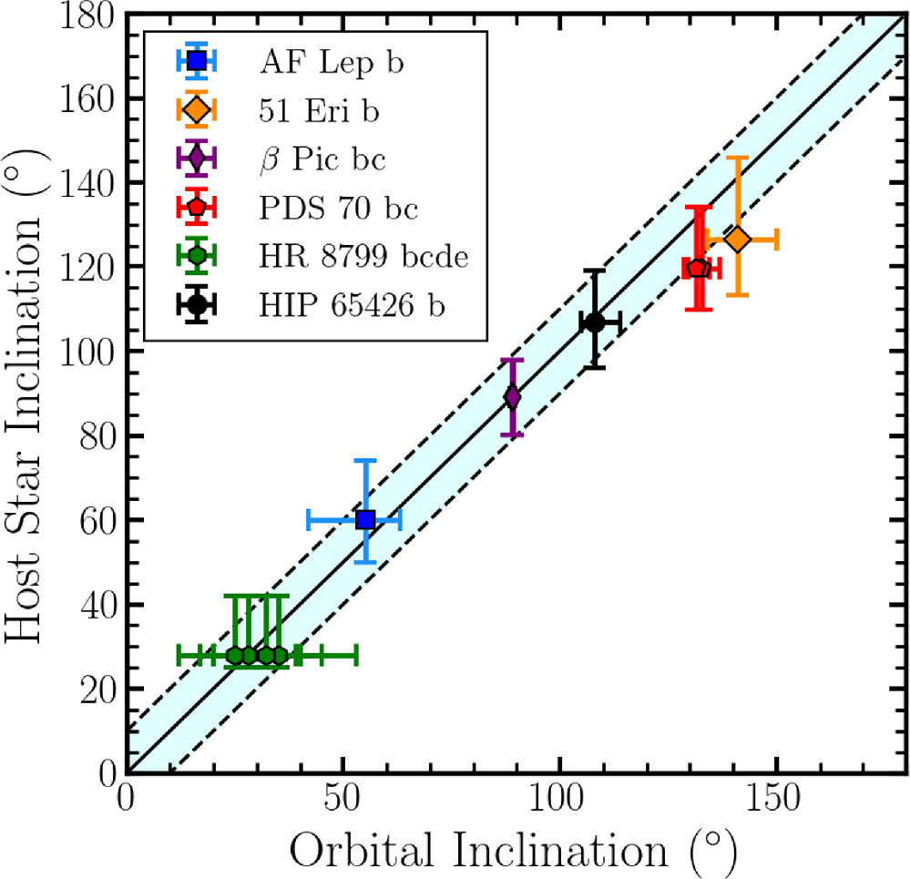
Growing population of aligned star-planet systems
Sepulveda et al. 2024

Slide 64
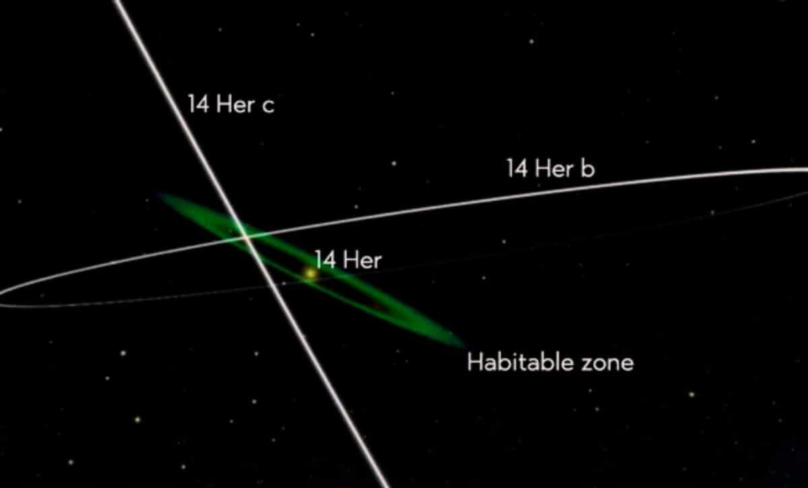
14 Her c: evidence of secular evolution with 14 Her b
Bardalez Gagliuffi & Balmer et al. 2025
Significant misalignment between star, b, and c -> suggests dramatic dynamical interactions and secular oscillations (exchanging eccentricity and inclination)

Slide 65
Interpretation of direct detections relies heavily on GP/BD evolutionary models and age estimates
Mass
Different models make different assumptions
Observable
Mass estimate
Constrained?

Slide 66
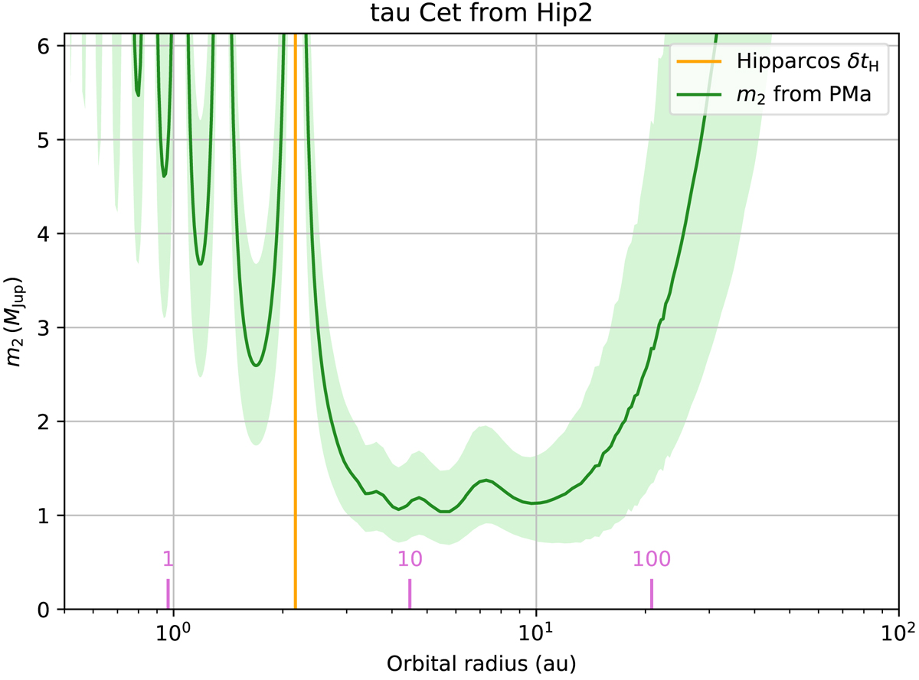
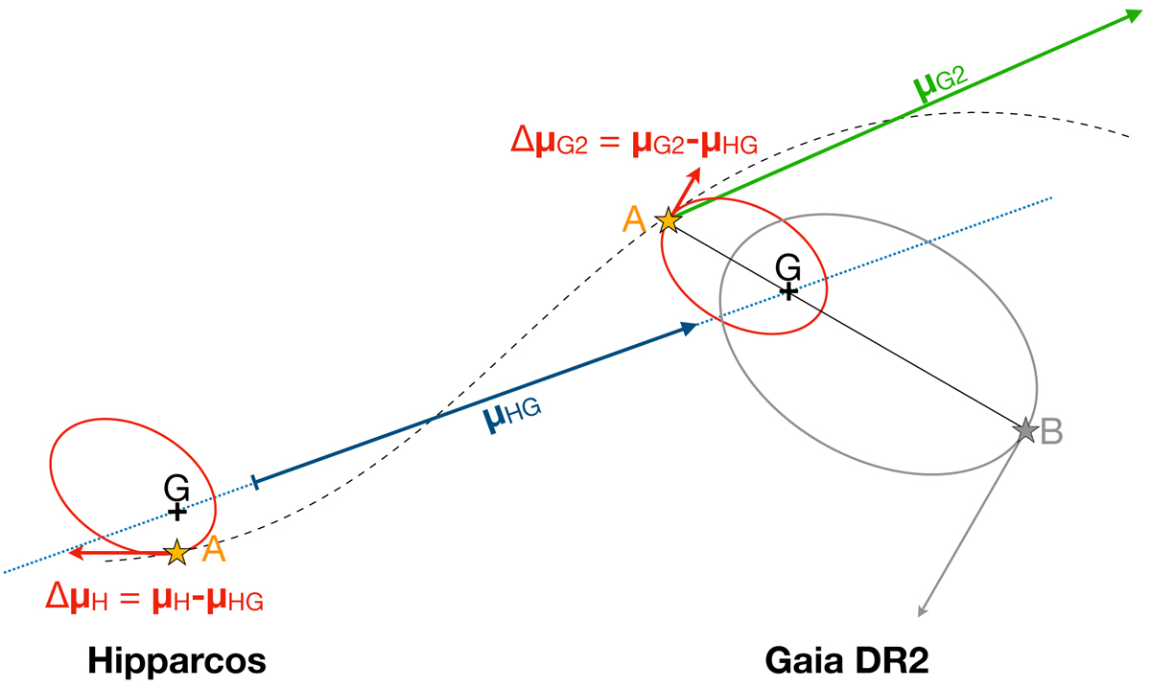
Direct imaging enables dynamical mass measurements -> tests of model predictions
Companion will fall on this line
Aliasing with obs window
disallowed

Slide 67
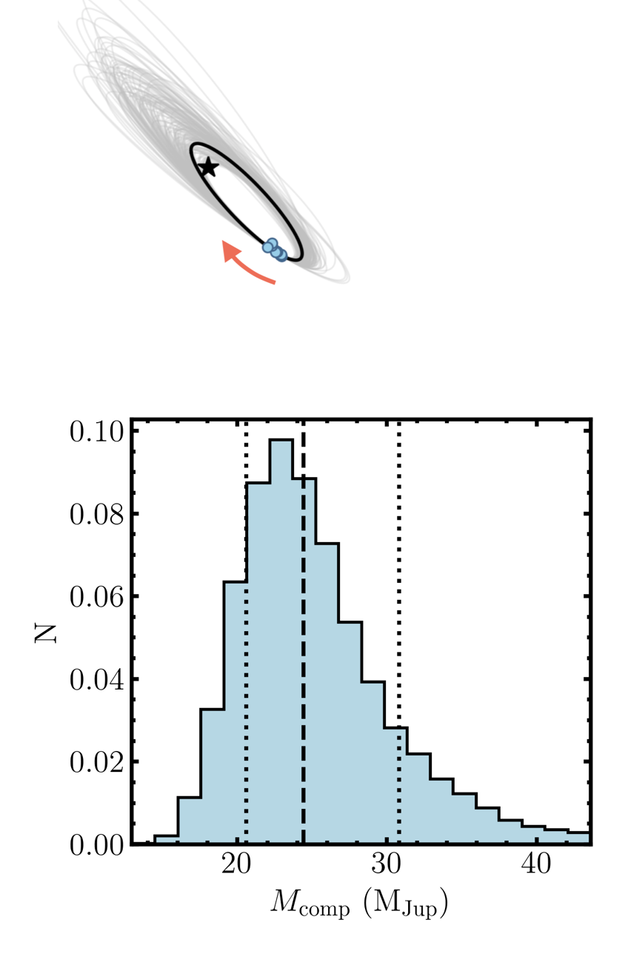
Proper motion anomaly for dynamical mass -> tests of GP/BD models
HIP 21152 B
Franson et al. 2023
Notes:
The most consistent model incorporates evolution of cloud properties

Slide 68
Direct imaging enables dynamical mass measurements -> tests of model predictions
Companion will fall on this line
Aliasing with obs window
disallowed

Slide 69





AF Lep b: lowest mass imaged exoplanet with dynamical mass
Franson et al. 2023
Keck NIRC2
Mesa et al. 2023
VLT/SPHERE
De Rosa et al. 2023
VLT/SPHERE

Slide 70



AF Lep b follow-up with JWST
Franson et al. 2024
Consistent with low metallicity + vigorous mixing or high metallicity + less mixing

Slide 71
Ok, but what about older, smaller, fainter planets?
Younger & Brighter
More massive
Evolved planetary systems?
Fainter
Dynamics?
Franson & Bowler 2023
Notes:
DI surveys have targeted young stellar systems, but to really probe planetary system evolution and dynamical processes, we should also look at older more evolved planetary systems, down here in this diagram

Slide 72

Older -> Colder -> longer wavelengths ; Lower mass -> fainter -> need better sensitivity
Lower mass
Older

Slide 73
Older -> Colder -> longer wavelengths ; Lower mass -> fainter -> need better sensitivity
Lower mass
Older

Slide 74


JWST MIRI can detect nearby planets as cold as our solar system
Bowens-Rubin, Mang et al. 2025: MIRI imaging can detect solar-system equivalent cold planets NIRCam could miss due to clouds
Custom cold models by James Mang
Coldest planet detectable at S/N = 3 [K]

Slide 75

eps Indi Ab: cold, old, and booming signal!
RV + Astr detected
K5V host
6.3 Mjup
~3.5 Gyr
275 K
👀
Matthews et al. 2024

Slide 76

14 Her c: coldest and oldest planet imaged to date
Bardalez Gagliuffi & Balmer et al. 2025
RV + Astr detected
7 Mjup
4.6 Gyr
275 K
Model fits (James Mang again) indicate carbon disequilibrium and/or water ice clouds

Slide 77
Direct imaging is tackling some key science questions
Properties of nearby planetary systems and how these properties inform formation and dynamical history
Chemical composition of Giant Planets and Brown Dwarfs and implication for atmospheric processes
Protoplanet interactions with gas, dust, circumplanetary disk
Planet forming disk characteristics, snowlines impact on planet formation
Debris disk characteristics and interaction with planets
Exomoons and exorings and connection to dynamical processes
Habitability of rocky planets and biosignatures

Slide 78

Resolving the planet means you can put a spectrograph on it separate from the star
Beta Pic b
Follette 2023

Slide 79

High resolution spectroscopy can derive robust elemental abundance ratios and planet properties
Wang et al. 2020
Gemini Planet Imager + VLT Gravity spectra

Slide 80
High resolution spectroscopy can derive robust elemental abundance ratios and planet properties
Wang et al. 2020
Gemini Planet Imager + VLT Gravity spectra
C/O ratio more consistent with core accretion than top-down, formation likely between the water and CO2 ice lines

Slide 81

JWST high-resolution spectroscopy delivers a wealth of information about BD atmosphere
Thermal Emission Spectrum of VHS 1256 B
~19 Mjup, Late L-type
Miles et al. 2023

Slide 82
JWST high-resolution spectroscopy delivers a wealth of information about BD atmosphere
Thermal Emission Spectrum of VHS 1256 B
~19 Mjup, Late L-type
Miles et al. 2023
Revealed disequilibrium chemistry and turbulent vertical mixing, presence of small silicate clouds

Slide 83
Direct imaging is tackling some key science questions
Properties of nearby planetary systems and how these properties inform formation and dynamical history
Chemical composition of temperate Neptunes and Giant Planets and implication for atmospheric processes
Protoplanet interactions with gas, dust, circumplanetary disk
Planet forming disk characteristics, snowlines impact on planet formation
Debris disk characteristics and interaction with planets
Exomoons and exorings and connection to dynamical processes
Habitability of rocky planets and biosignatures

Slide 84

Young forming protoplanets are probed visible AO via Halpha emission
PDS 70 b: First detection of planet in forming disk.
Directly imaged in IR on VLT/SPHERE
(Keppler et al. 2018)
Müller et al. 2018

Slide 85

Young forming protoplanets are probed visible AO via Halpha emission
PDS 70 b: First detection of planet in forming disk.
Directly imaged in IR on VLT/SPHERE
(Keppler et al. 2018)
PDS 70 c: discovered via Halpha emission
Müller et al. 2018
Haffert et al. 2019

Slide 86

Young forming protoplanets are probed visible AO via Halpha emission
MagAO-X
PDS-70 b&c,
Close et al. 2025a
First detection of circumplanetary disk in scattered light within a circumstellar disk

Slide 87

Young forming protoplanets are probed visible AO via Halpha emission
MagAO-X
PDS-70 b&c,
Close et al. 2025a
WISPIT-2 b,
Close et al. 2025b
First detection of forming protoplanet within a ring, appears to be carving dust free gap

Slide 88

Young forming protoplanets are probed visible AO via Halpha emission
MagAO-X
PDS-70 b&c,
Close et al. 2025a
2M J1612 b,
Li et al. 2025
WISPIT-2 b,
Close et al. 2025b
Third ever discovery, needs confirmation

Slide 89

MagAO-X has traced variable accretion through time
Close et al. 2025b
First unambiguous detections of variable Halpha line flux

Slide 90
Direct imaging is tackling some key science questions
Properties of nearby planetary systems and how these properties inform formation and dynamical history
Chemical composition of temperate Neptunes and Giant Planets and implication for atmospheric processes
Protoplanet interactions with gas, dust, circumplanetary disk
Planet forming disk characteristics, snowlines impact on planet formation
Debris disk characteristics and interaction with planets
Exomoons and exorings and connection to dynamical processes
Habitability of rocky planets and biosignatures

Slide 91
Direct imaging is tackling some key science questions
Properties of nearby planetary systems and how these properties inform formation and dynamical history
Chemical composition of temperate Neptunes and Giant Planets and implication for atmospheric processes
Protoplanet interactions with gas, dust, circumplanetary disk
Planet forming disk characteristics, snowlines impact on planet formation
Debris disk characteristics and interaction with planets
Exomoons and exorings and connection to dynamical processes
Habitability of rocky planets and biosignatures
Science of looking at a very faint thing very close to a very bright thing

Slide 92

Debris disk thermal imaging constrains composition
HD 141569
MagAO/CLIO instrument
Kueny et al. 2024
Morphology in different bands points to PAHs and icy grains being vertically mixed into upper layers

Slide 93

MagAO-X is producing highest angular resolution images of debris disks
HR 4796
Visible scattered light
Constrains phase function -> composition

Slide 94

MagAO-X is visible AO -> find new WD+ early type MS binaries
Pearce et al. 2025a

Slide 95
Direct imaging is tackling some key science questions
Properties of nearby planetary systems and how these properties inform formation and dynamical history
Chemical composition of temperate Neptunes and Giant Planets and implication for atmospheric processes
Protoplanet interactions with gas, dust, circumplanetary disk
Planet forming disk characteristics, snowlines impact on planet formation
Debris disk characteristics and interaction with planets
Exomoons and exorings and connection to dynamical processes
Habitability of rocky planets and biosignatures

Slide 96
Direct imaging is tackling some key science questions
Properties of nearby planetary systems and how these properties inform formation and dynamical history
Chemical composition of temperate Neptunes and Giant Planets and implication for atmospheric processes
Protoplanet interactions with gas, dust, circumplanetary disk
Planet forming disk characteristics, snowlines impact on planet formation
Debris disk characteristics and interaction with planets
Exomoons and exorings and connection to dynamical processes
Habitability of rocky planets and biosignatures
Very soon!

Slide 97


The Future is Bright for HCI

Slide 98



MagAO-X: ExAO visible light instrument
PI: Jared Males
Extreme Wavefront Control Lab
Univ of Arizona/Steward Observatory

Slide 99
Visible AO probes colder/smaller planets through reflected light

Slide 100
MagAO-X: ExAO visible light instrument
Detection of exoplanets in reflected light is the ultimate science goal of MagAO-X
PI: Jared Males
Extreme Wavefront Control Lab
Univ of Arizona/Steward Observatory

Slide 101

A lot of work is needed to achieve contrasts necessary to detect known exoplanets in reflected light

Slide 102

Roman CGI will deliver reflected light exoplanets
Credit: Vanessa Bailey
From: https://github.com/nasavbailey/DI-flux-ratio-plot

Slide 103

Habitable worlds (HWO) will detect Earth-like planets in HZ in reflected light
Simulation of our solar system viewed with a Hab Worlds-like platform
From: https://science.nasa.gov/astrophysics/programs/habitable-worlds-observatory/

Slide 104




Exomoons and Exorings complicate exoplanet detections!
Work by UM undergrad Sam Hopper
Hopper et al. (submitted)
Rings brighter than Saturn
Triton brighter than Neptune

Slide 105

Hab worlds (HWO) will detect Earth-like planets in HZ in reflected light
And rings and moons!
Mostly Saturn’s rings
Earth + some moon light
(that might impact your spectral retrieval!)

Slide 106



Roman can use phase curves to distinguish rings
Work by UM undergrad Lizzie Lane
Lane et al. (in prep)

Slide 107
Ground based HCI complements space-based
Giant Magellan Telescope (GMT)
Extremely Large Telescope (ELT)
Thirty Meter Telescope (TMT)
Roman
HWO
Space based:
- Lower background -> higher contrasts
- Smaller primary -> wider separations
Ground based:
- Higher background -> lower contrasts
- Larger primary -> closer separations

Slide 108



ELT, GMT, TMT instruments for direct imaging science
ELT
GMT
TMT
Thermal: ELT-METIS
1st gen instrument
Visible: ELT-PCS
2nd gen instrument
Thermal: GMTNIRS
1st gen instrument
Visible: GMagAO-X
1st gen instrument
Thermal: IRIS & MODHIS
1st gen instrument
Visible: TMT PSI
2nd gen instrument

Slide 109

HWO

Slide 110



O2 detection is only available to direct spectroscopy
Hardegree-Ullman et al. 2023
Hardegree-Ullman et al. 2025

Slide 111

New coronagraph designs, AO operating modes are achieving required contrasts in lab
EFC
Kenworthy &
Haffert 2025

Slide 112
New coronagraph designs, AO operating modes are achieving required contrasts in lab
Direct reflected light detection is on the horizon in the next few years with MagAO-X and Roman
EFC
Kenworthy &
Haffert 2025

Slide 113
Summary
More at www.loganpearce.com
(including these slides!)
Direct exoplanet imaging delivers exoplanet atmospheres, formation mechanisms, mass, population statistics, potentially biosignatures
High contrast imaging is achieved through a combination of adaptive optics, coronagraphy, and post-processing
JWST is making enormous breakthroughs in thermal emission imaging of cold exoplanets, white dwarfs planets, atmospheric spectra, and more
Current ground-based platforms are delivering new discoveries, dynamical masses, forming protoplanets, formation process probes, and more
The next generation space- and ground-based platforms will deliver reflected light detections for the first time
Technology breakthroughs will deliver contrasts and separations necessary to image HZ planets and eventually exo-Earths (if they exist) soon!

Slide 114

White Dwarf planets: Planetary system at the end of their star’s lifetime
WD 1856 b
Discovered via transit (Vanderburg et al. 2020)
~5 Mjup
~10 Gyr
184 K
(Limbach et al. 2025)

Slide 115



White Dwarf planets: Planetary system at the end of their star’s lifetime
Limbach et al. 2024
Limbach et al. 2025

Slide 116


JWST GO 7612: HZ planets around Sirius B
F1800W/F2100W
F2550W

Slide 117

MagAO-X is gearing up for reflected light campaign in the next few years

Slide 118

MagAO-X is gearing up for reflected light campaign in the next few years
Pearce et al. 2025b
Predication of Prox Cen b location on a given date with current best orbit fit

